Slide 1
Counters
&
Shift Registers
Goutham Makkena

Slide 2

Counters
A register that goes through a prescribed sequence of states upon the application of input pulses is called a counter
The input pulses may be clock pulses, or from some external source and may occur at a fixed interval of time or at random.
The sequence of states may follow the binary number sequence or any other sequence of states
A counter that follows the binary number sequence is called a binary counter
An n‐bit binary counter consists of n flip‐flops and can count in binary from 0 through (2^{n} – 1). It is also called MOD-2^{n} counter

Slide 3
Counters
Counters are available in two categories:
Ripple Counters or Asynchronous Counters
Synchronous Counters
In a ripple counter, a flip‐flop output transition serves as a clock for triggering other flip‐flops
In other words, the Clock input of some or all flip‐flops are triggered, not by the common clock pulses, but rather by the transition that occurs in other flip‐flop outputs
In a synchronous counter, the Clock inputs of all flip‐flops receive the common clock

Slide 4
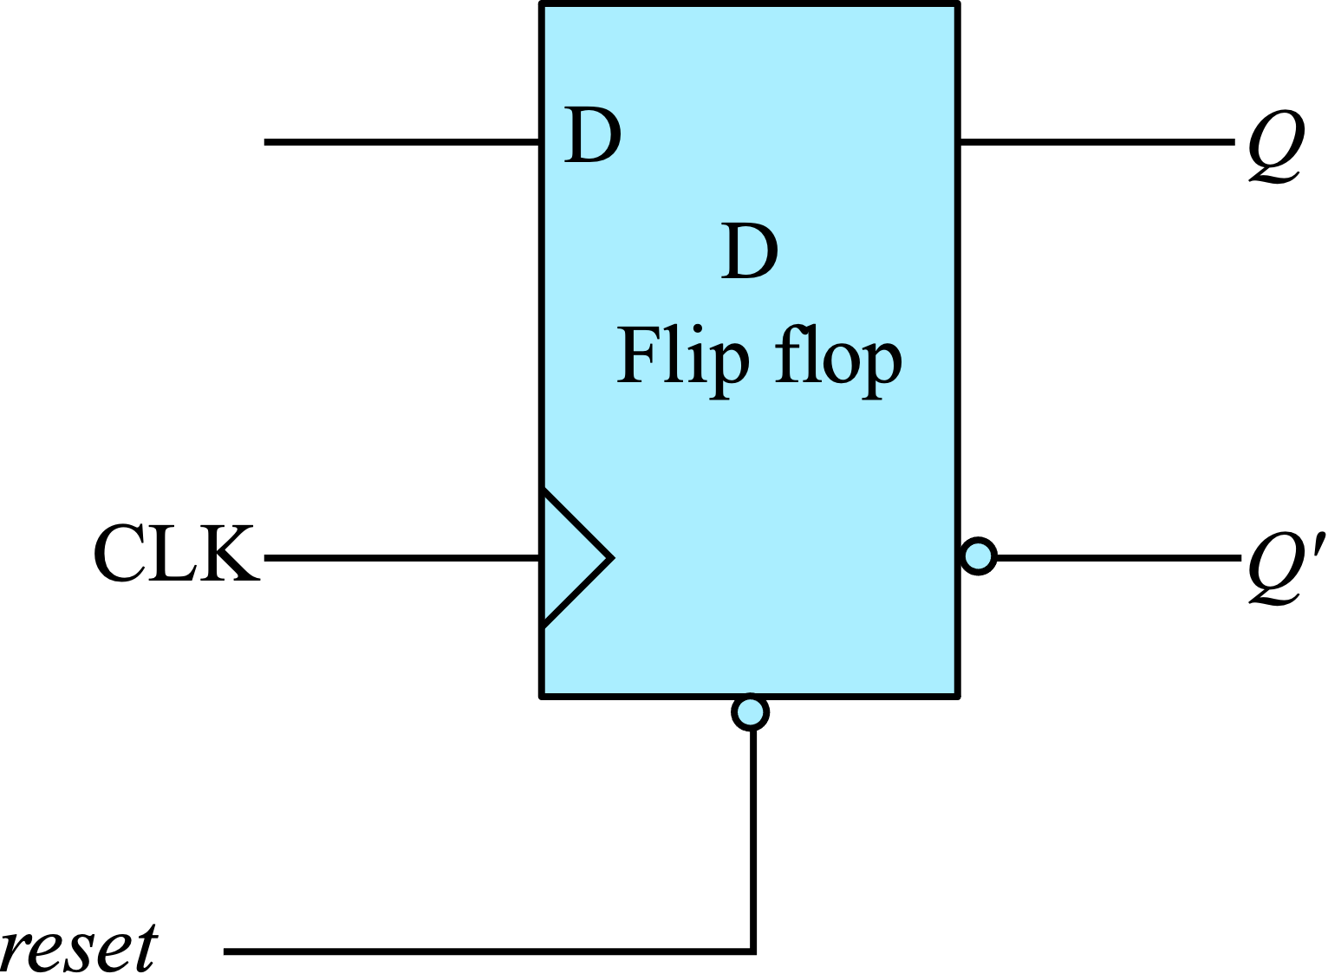
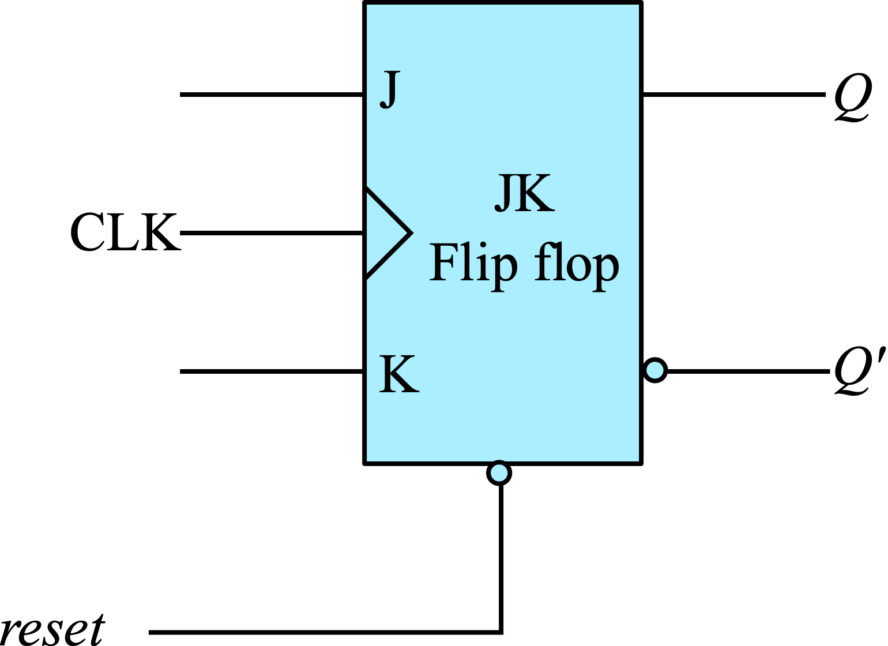

Flip flops with asynchronous Inputs
All the flip flops that we have learnt so far also have asynchronous inputs
Flip Flops usually respond to inputs only during transition clock (either at positive edge or negative edge).
However, all practical flip flops have extra asynchronous inputs like reset . These asynchronous inputs are usually active low.
When reset input is low, the output is reset. The reset input works irrespective of the edge of the clock. That is why it is called asynchronous input
T- Flip Flop with asynchronous reset
JK- Flip Flop with asynchronous reset
D- Flip Flop with asynchronous reset

Slide 5
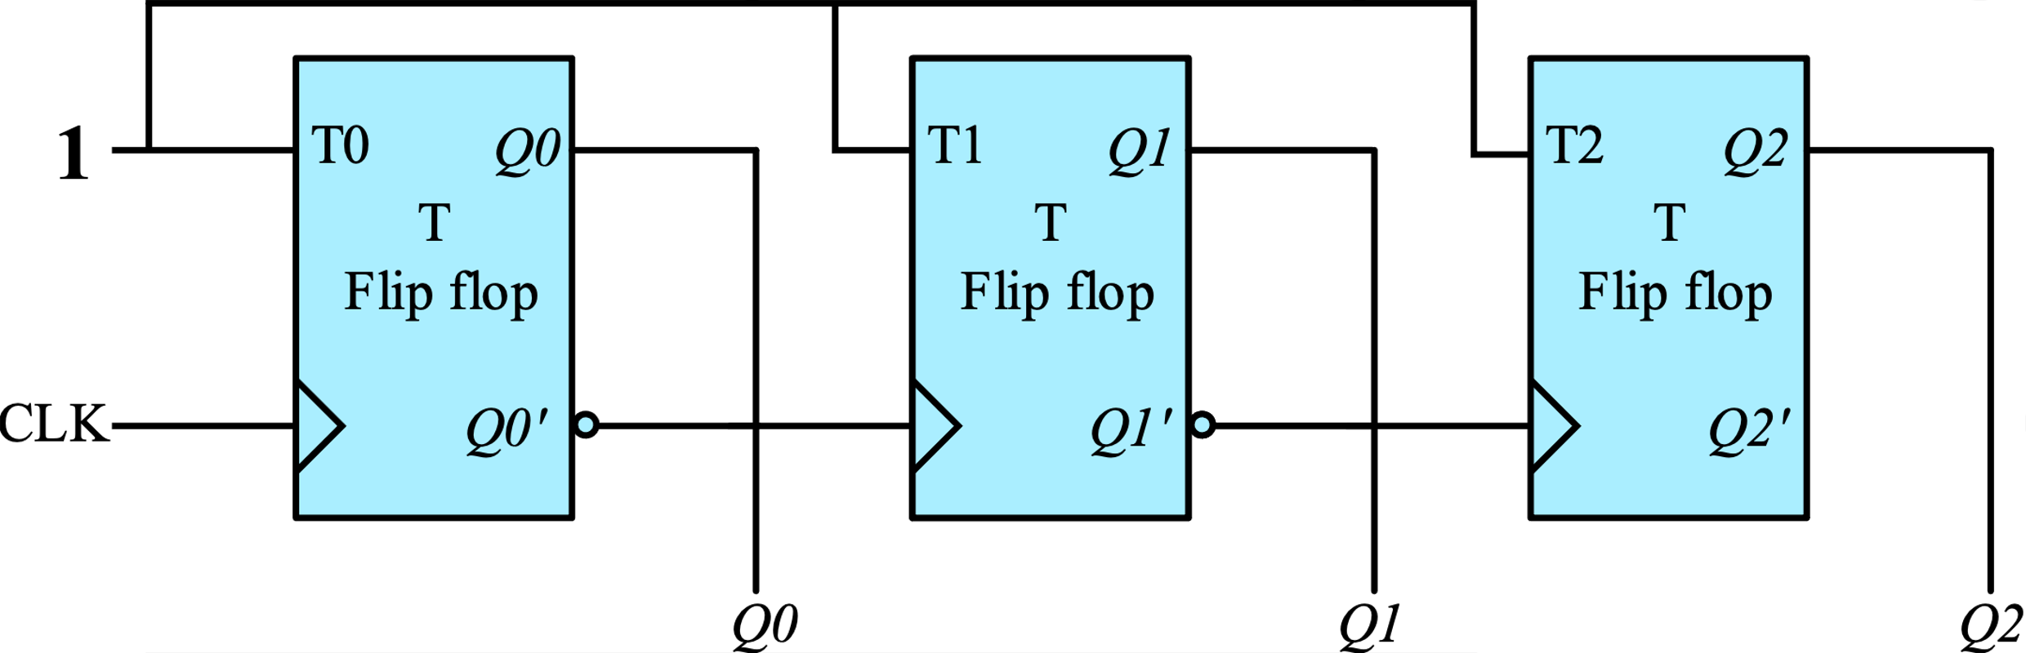
Binary Ripple Counters
A binary ripple counter consists of a series connection of complementing flip‐flops, with the output of each flip‐flop connected to the Clock input of the next higher order flip‐flop
Figure below gives a three-bit up-counter (MOD-8) capable of counting from 0 to 7
***** Refer to the animation for waveforms and better understanding *****

Slide 6
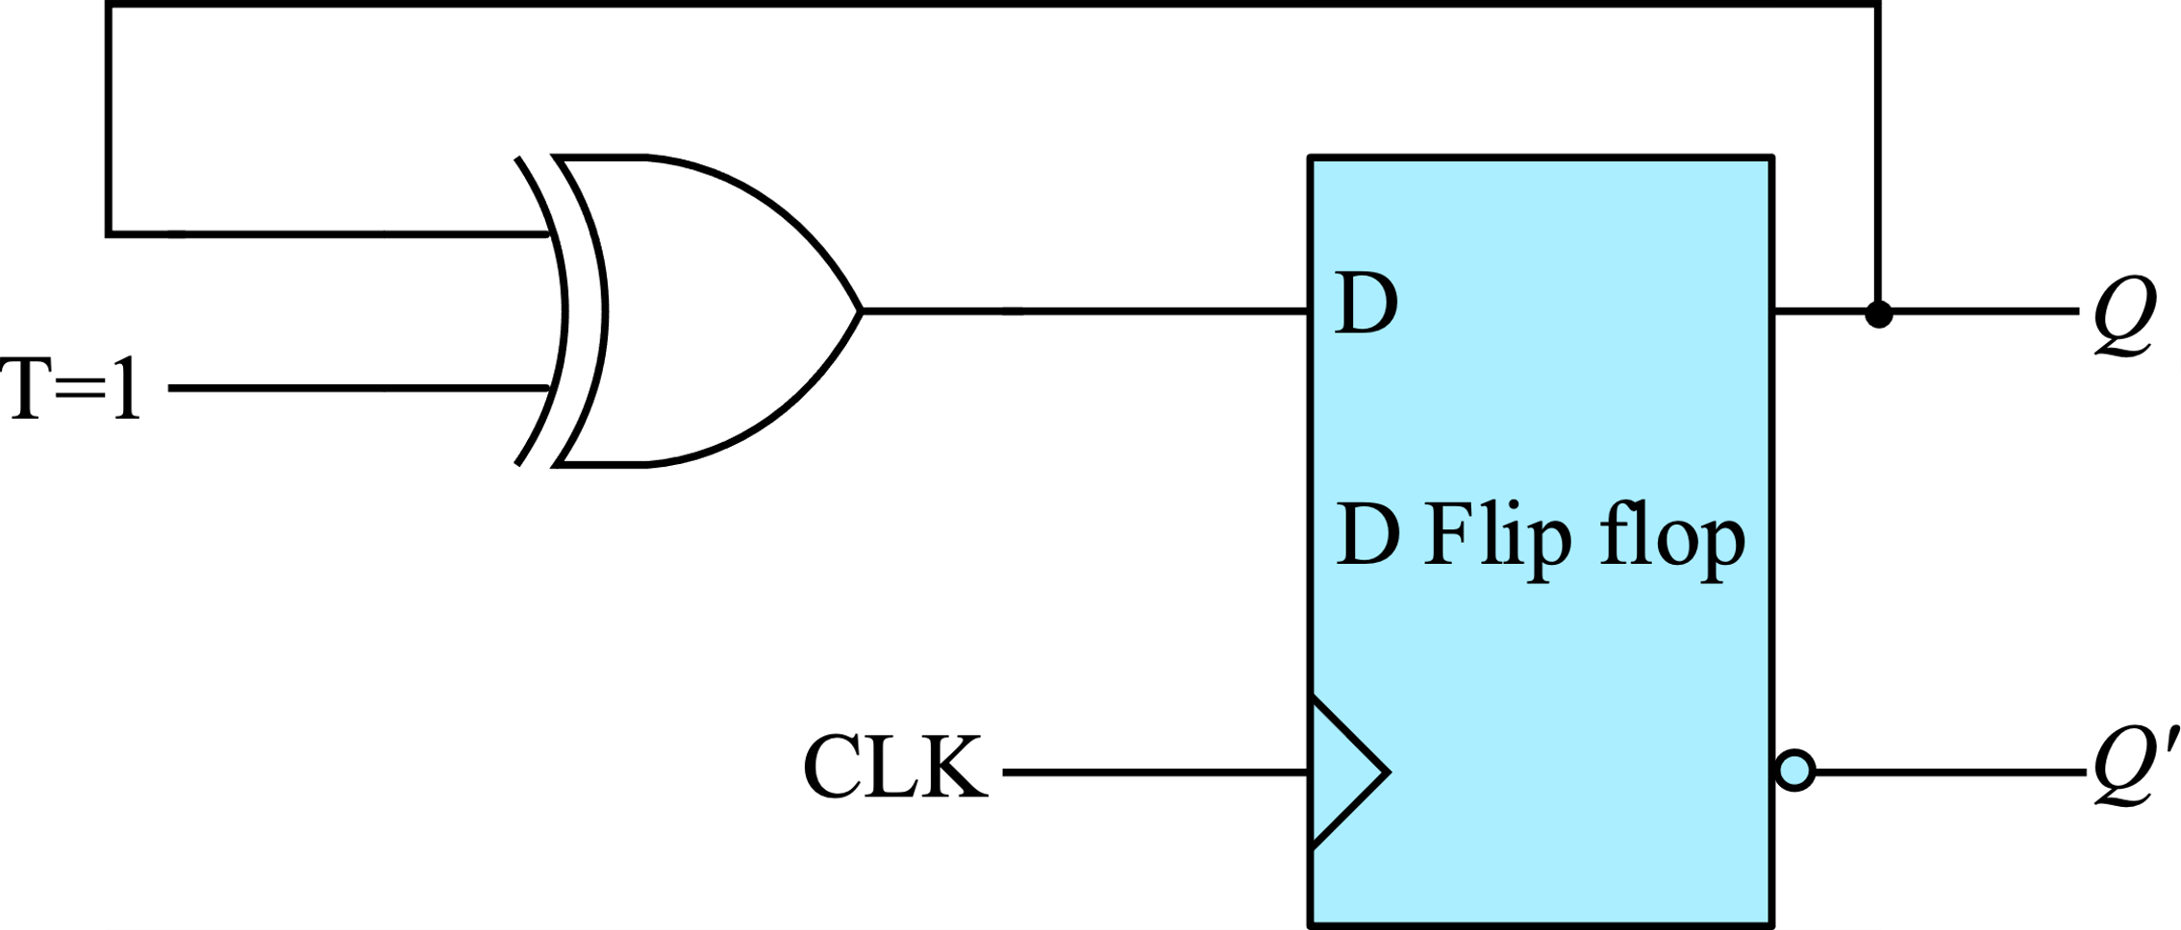
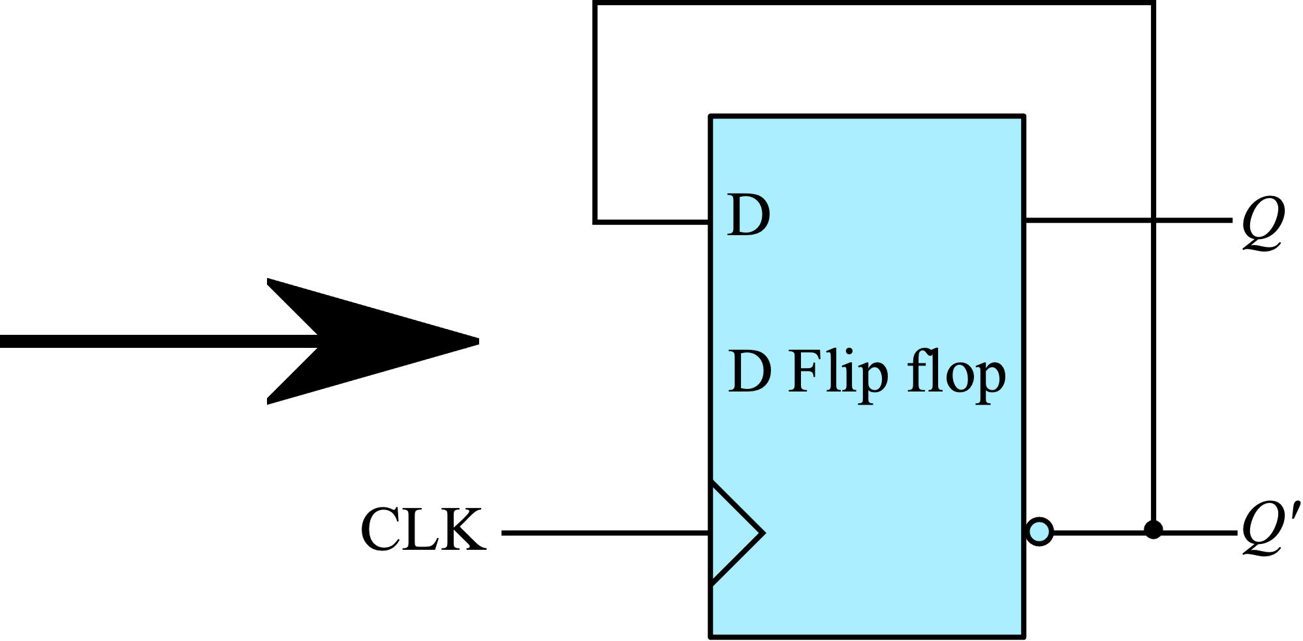
Binary Ripple Counters
The binary ripple counter can be implemented using D flip flops
Suppose the T flip flop in the counter is implemented from D flip flop
In the ripple counter, T input is always high

Slide 7
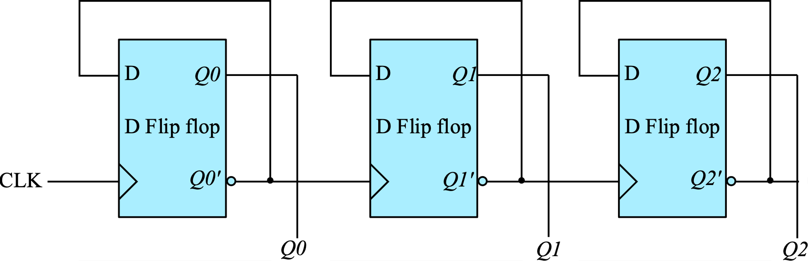
Binary Ripple Counters
The binary ripple counter implemented using D flip flops

Slide 8

Binary Ripple Counters
Figure below gives a three-bit down-counter (MOD-8) capable of counting from 7 to 0
A slight modification of the Up counter gives us the down counter.
Instead of Q’ of the previous flip flop given as clock to the next flip flop, down counter gets Q of the previous flip flop as the clock to the next flip flop
3-bit down counter using T flip flops

Slide 9
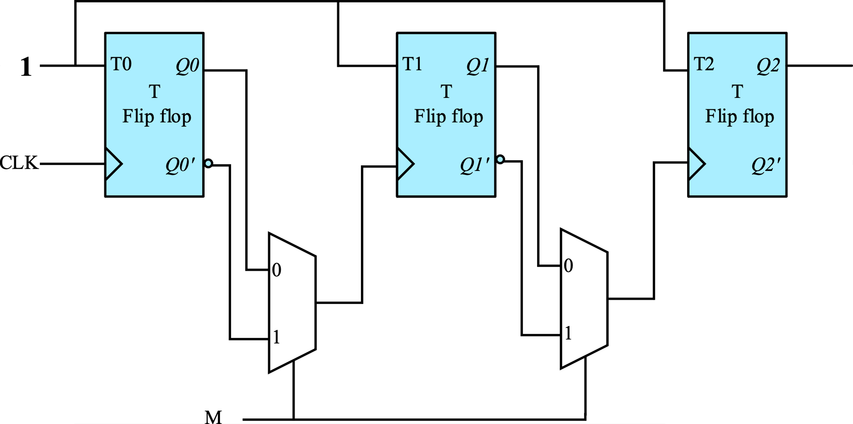
Binary Ripple Up/down Counters
Figure below gives a three-bit up/down-counter
When M=0, it acts as a down counter and when M=1 it acts as a up counter
3-bit up/down counter using T flip flops

Slide 10
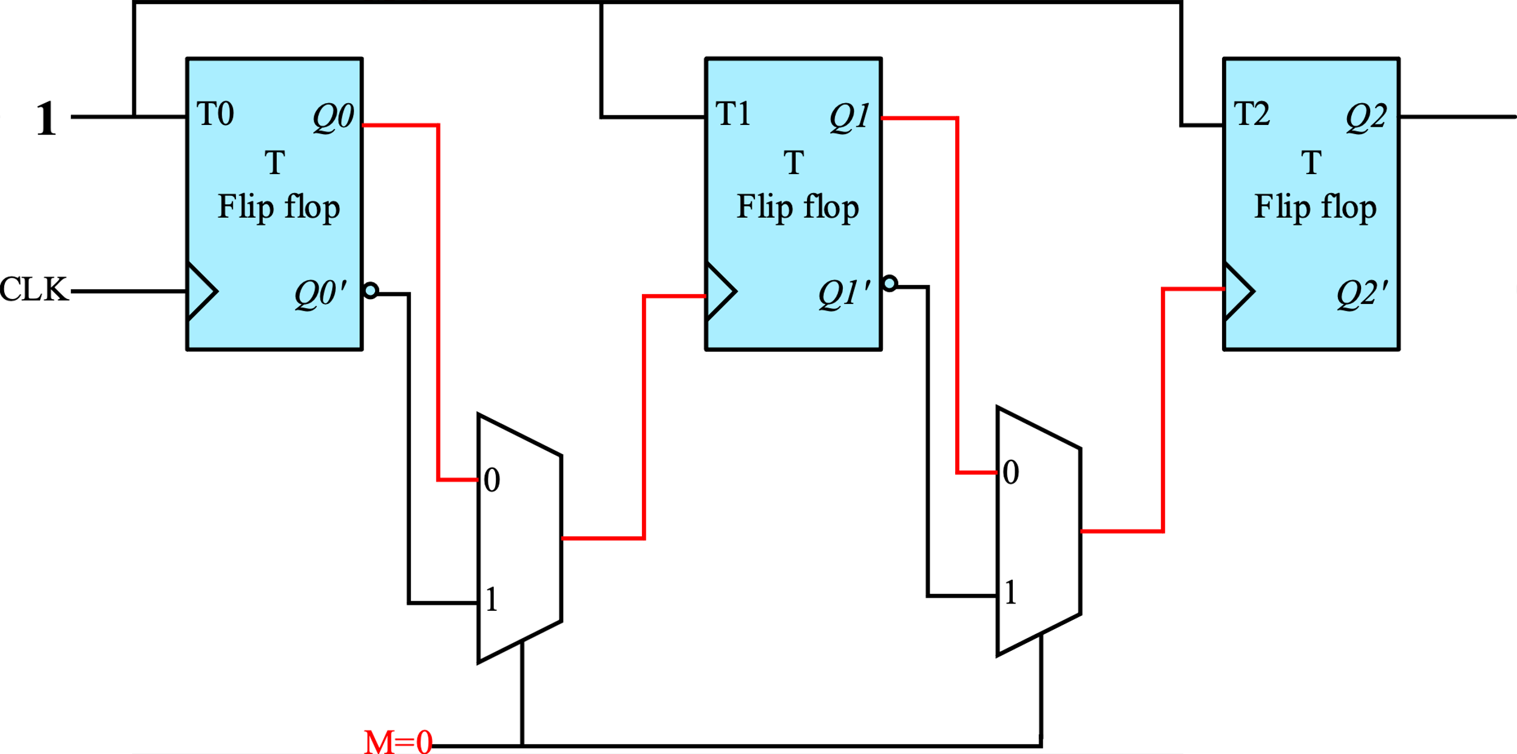
Binary Ripple Up/down Counters
When M=0, Q is going as clock input to next flip flop. So it acts as a down counter
3-bit up/down counter using T flip flops

Slide 11
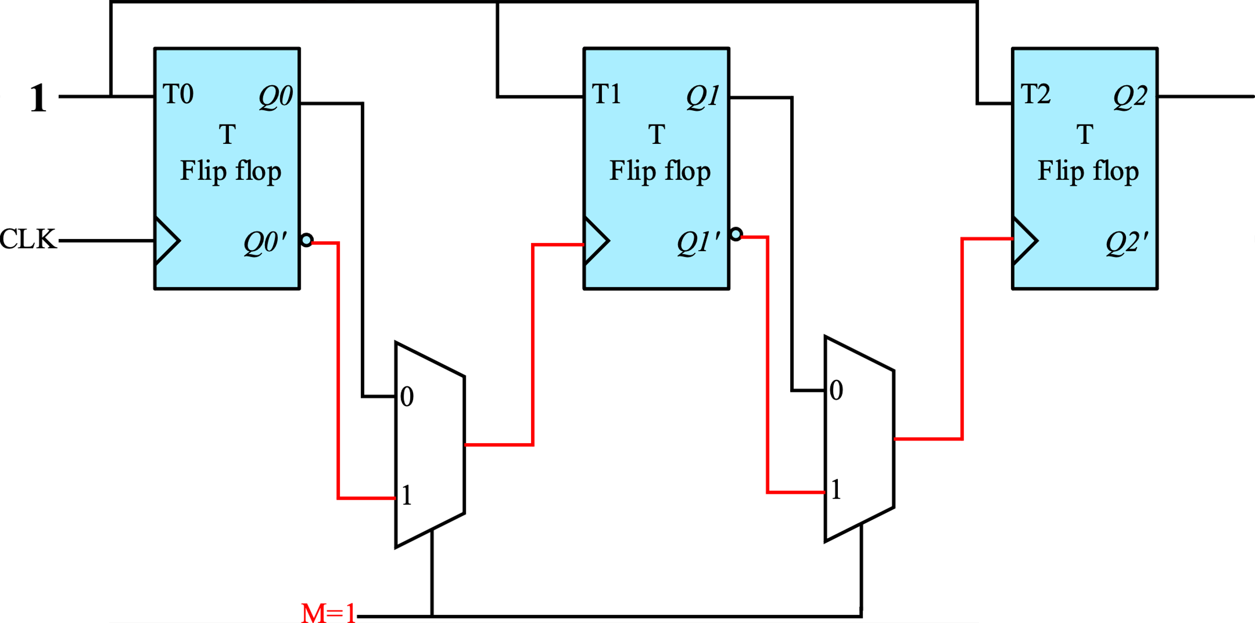
Binary Ripple Up/down Counters
When M=1, Q’ is going as clock input to next flip flop. So it acts as a up counter
3-bit up/down counter using T flip flops

Slide 12
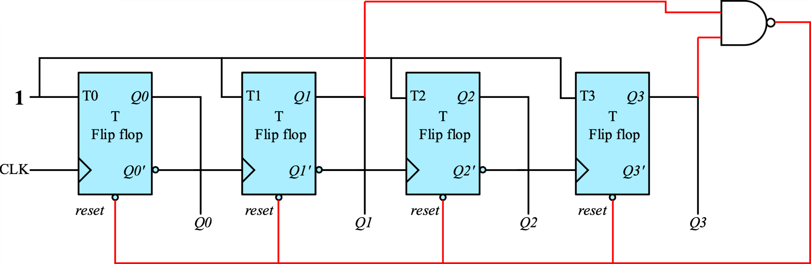
BCD Ripple Counter
A decimal counter follows a sequence of 10 states and returns to 0 after the count of 9
Such a counter must have at least four flip‐flops to represent each decimal digit, since a decimal digit is represented by a binary code with at least four bits.
A BCD counter starts at 0000 and counts till 1001 after which it goes back to 0000
BCD ripple counter (MOD-10) can be achieved by resetting the counter as soon as it reaches 1010

Slide 13
Synchronous Counter
Synchronous counters are different from ripple counters in that clock pulses are applied to the inputs of all flip‐flops
A common clock triggers all flip‐flops simultaneously, rather than one at a time in succession as in a ripple counter
Synchronous binary counters can be designed from the state diagram and converting it to its corresponding logic diagram

Slide 14
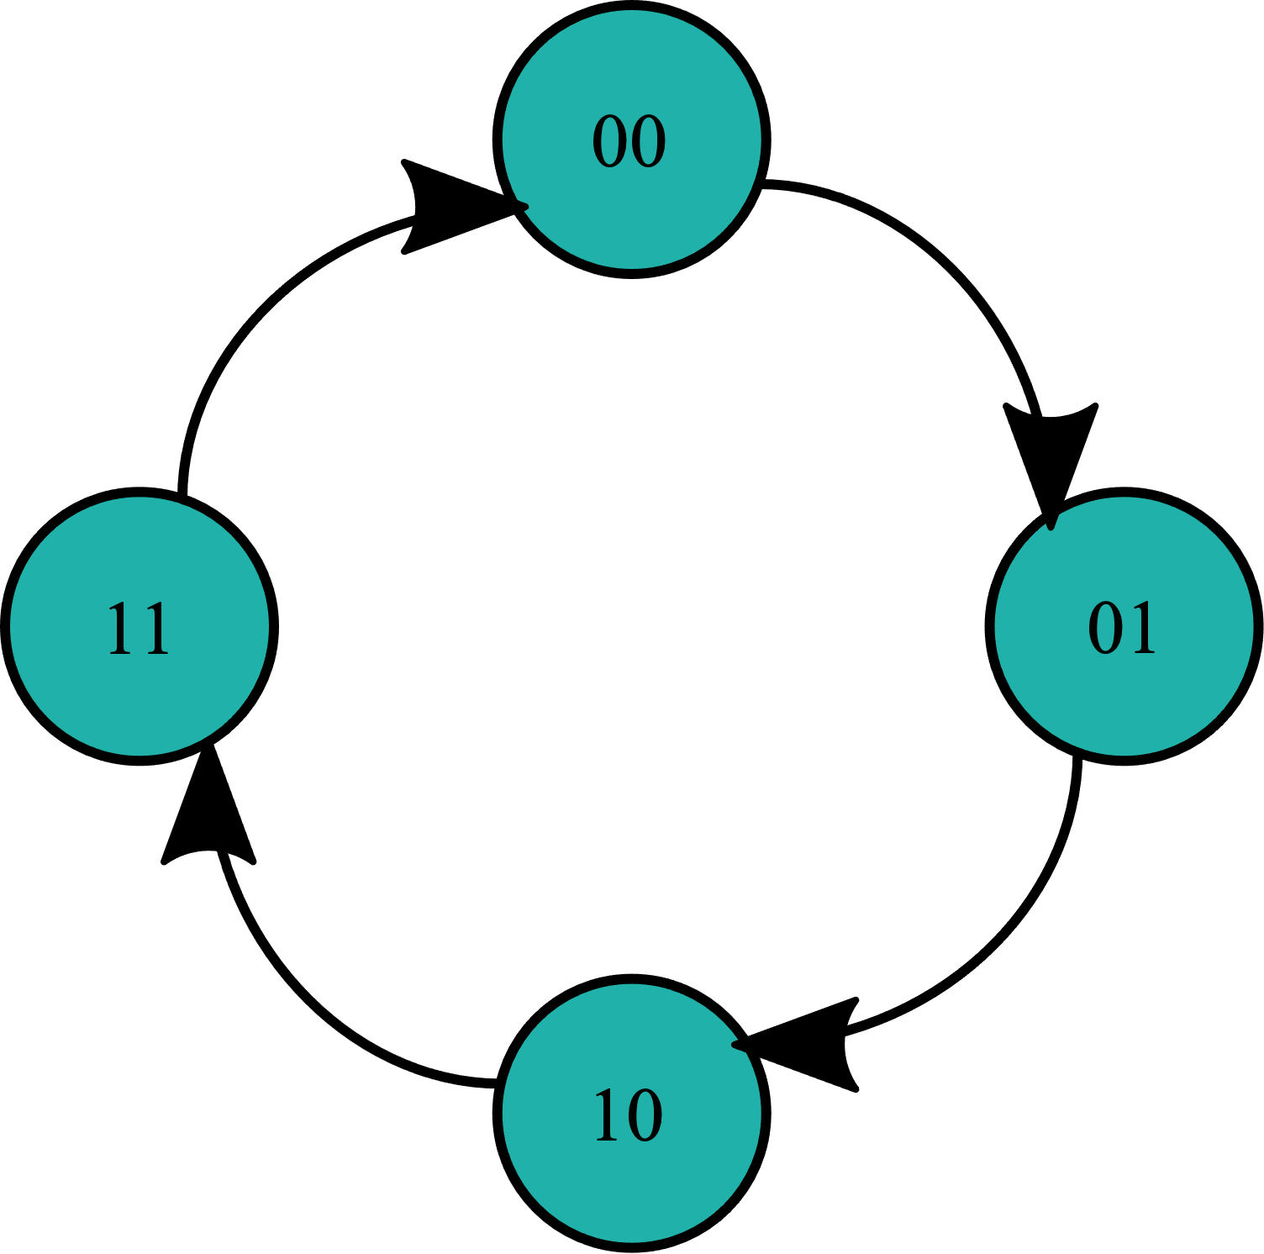
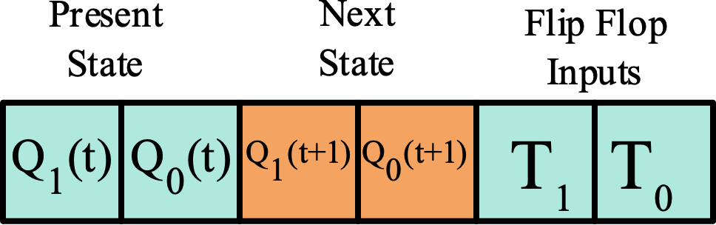











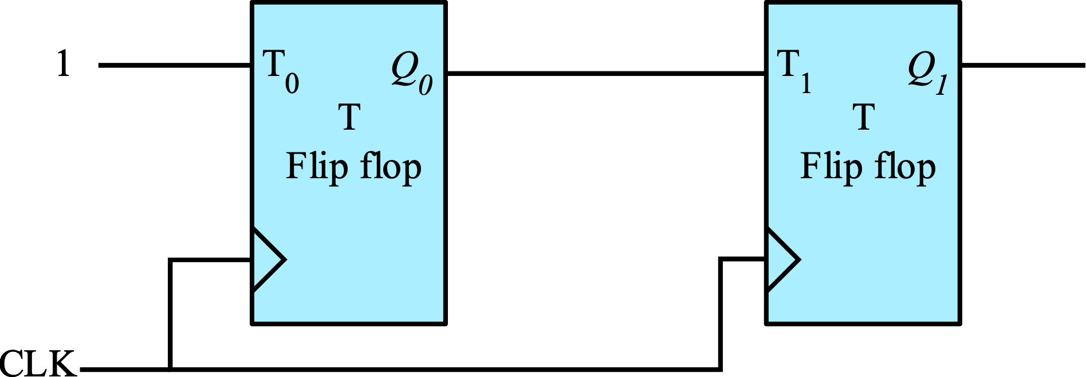
2-bit Synchronous Counter
Below is the state diagram of a 2-bit binary counter
The corresponding state table if the counter is to be implemented with T flip flops

Slide 15
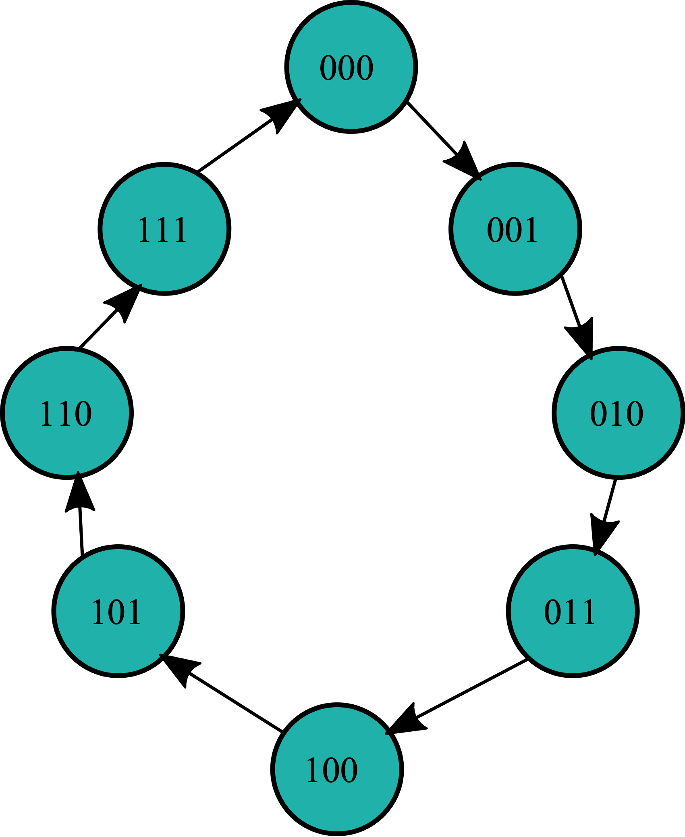
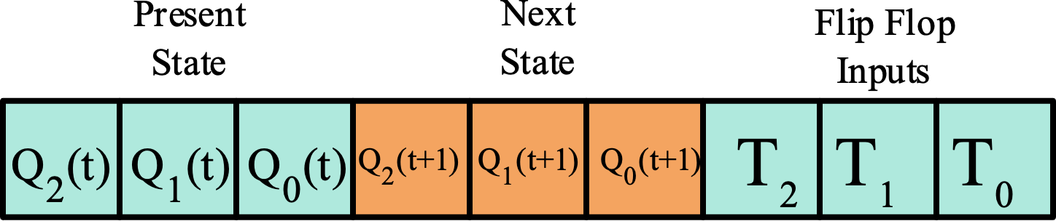























3-bit Synchronous Counter
Below is the state diagram of a 3-bit binary counter
The corresponding state table if the counter is to be implemented with T flip flops

Slide 16
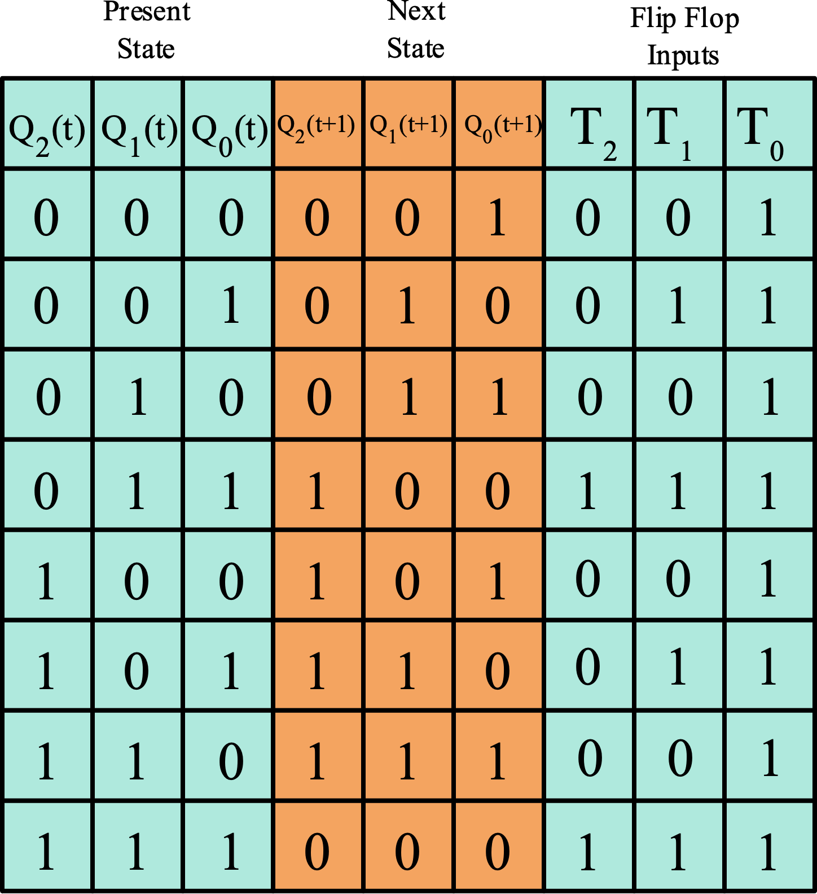
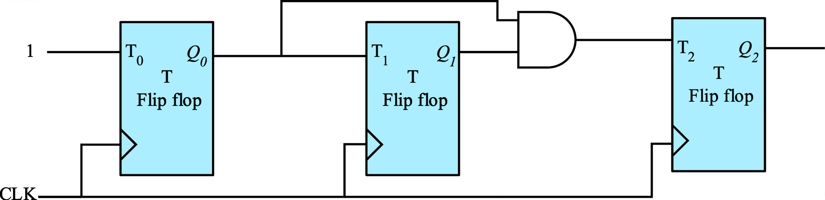
3-bit Synchronous Counter
T2 = Q₁Q₀
T1 = Q₀
T0 = 1

Slide 17
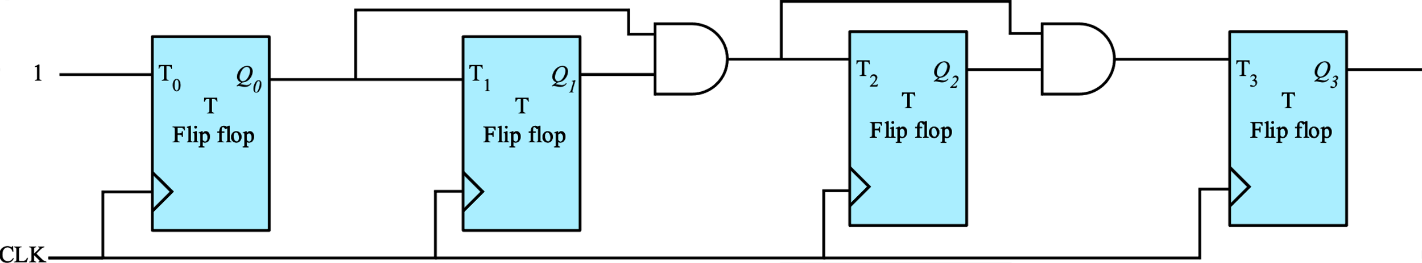
4-bit Synchronous Counter
A 4-bit synchronous counter also can be designed by following the same procedure. The logic diagram is shown below
T3 = Q₀Q₁ Q₂
T2 = Q₀Q₁
T1 = Q₀
T0 = 1
From the flip-flop input equations of the 2-bit , 3-bit and 4-bit counters, it is clear that they are following a certain pattern

Slide 18
n-bit Synchronous Counter
From the flip-flop input equations of the 2-bit , 3-bit and 4-bit counters, it is clear that they are following a certain pattern
A n-bit synchronous counter can therefore be built with T flip flops with T inputs as
T0 = 1
T1 = Q₀
T2 = Q₀Q₁
T3 = Q₀Q₁ Q₂
Tn = Q₀Q₁ Q_{2……} Q_{n-1}

Slide 19
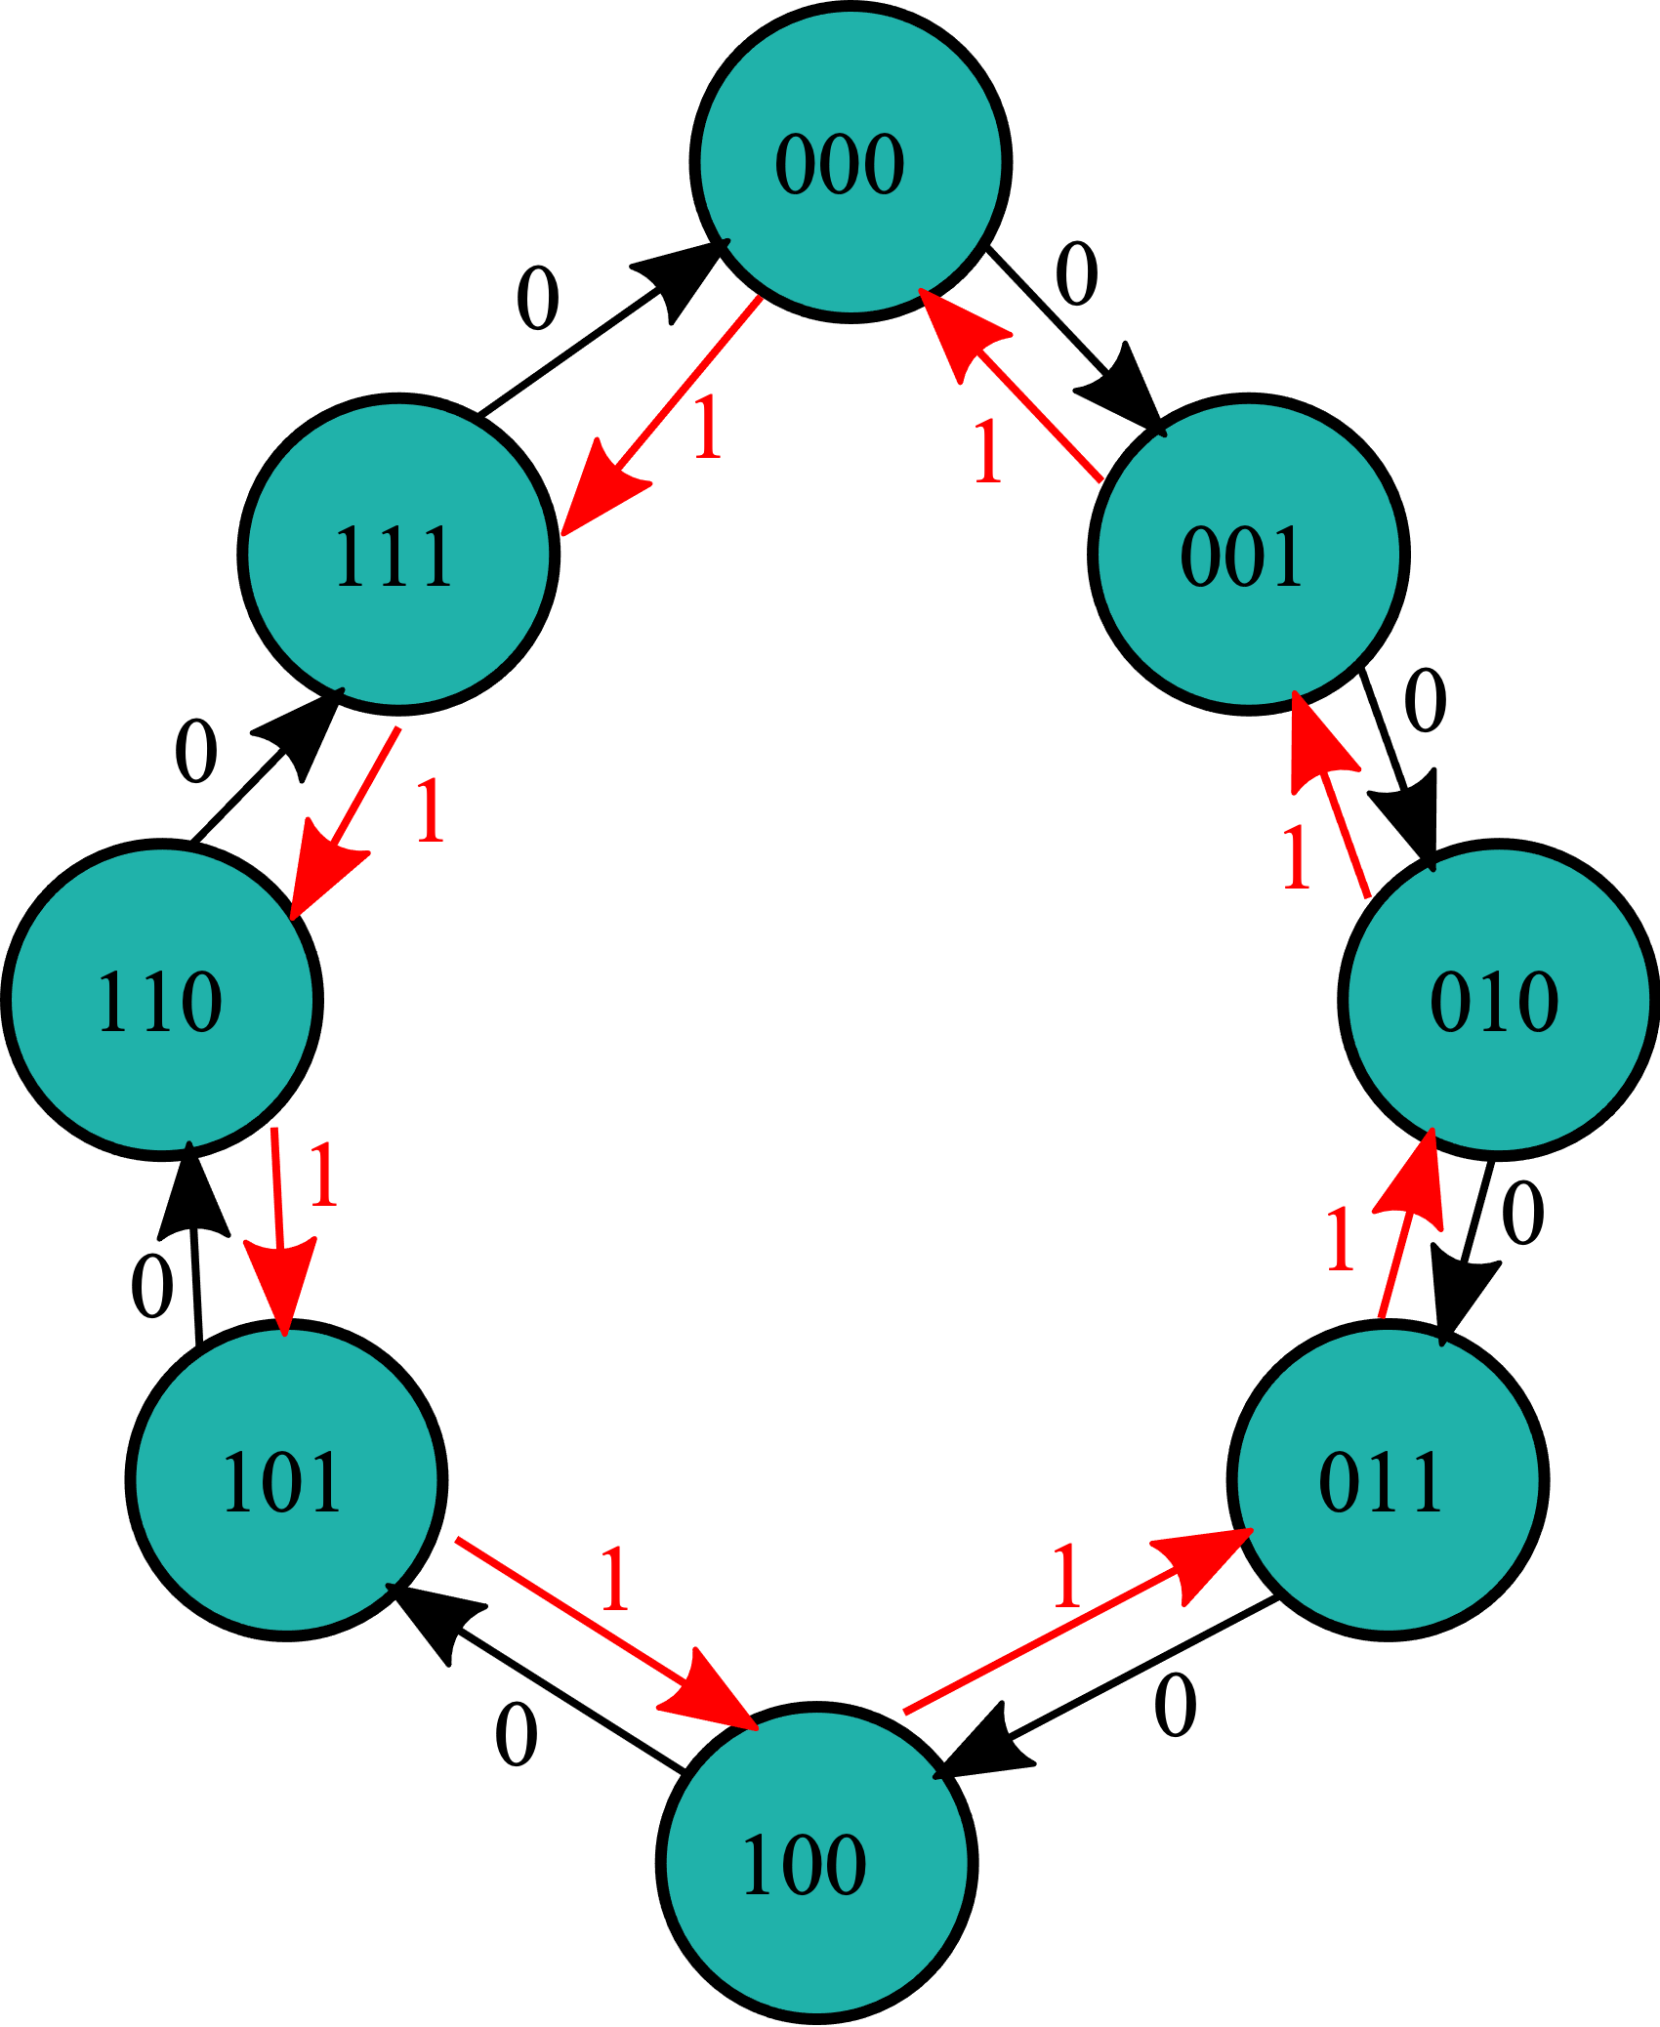
MOD-8 UP/Down synchronous Counter
A MOD – 8 Up/Down counter has an input M, which decides whether the counter should act as up counter or down counter
If M=0, the counter acts as an Up counter and if M=1, it acts a down counter. The corresponding state diagram is shown below

Slide 20
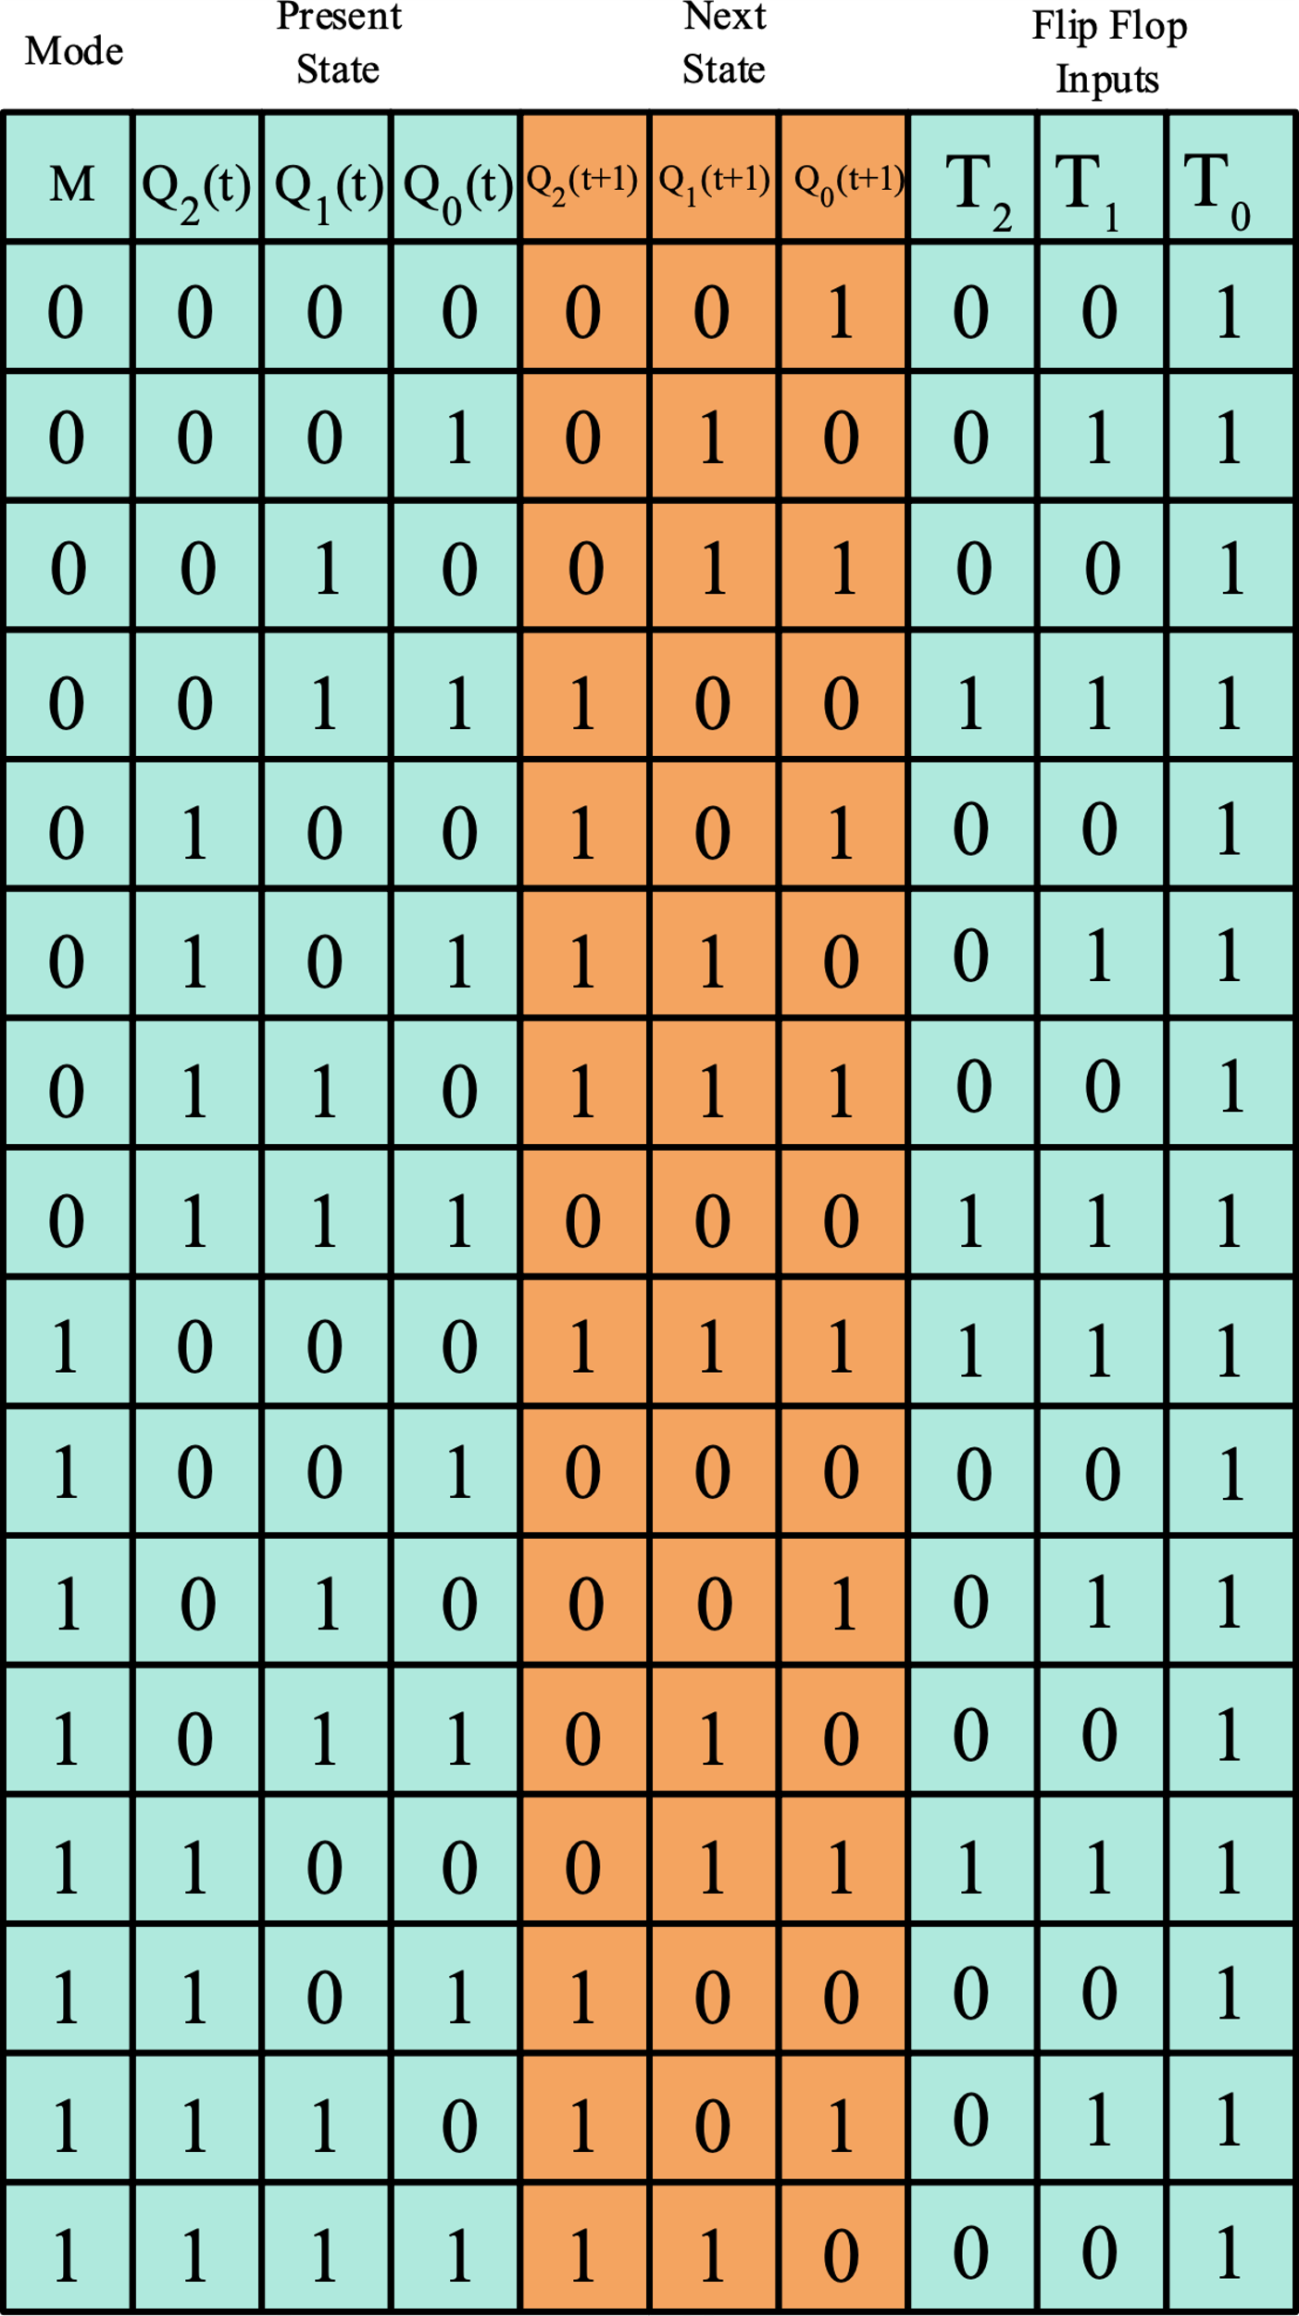
MOD-8 UP/Down synchronous Counter
State Diagram
State Table
From the state table
obtain the expressions
for T2, T1 and T0 in terms of M, Q2, Q1 and Q0 and draw the logic diagram

Slide 21
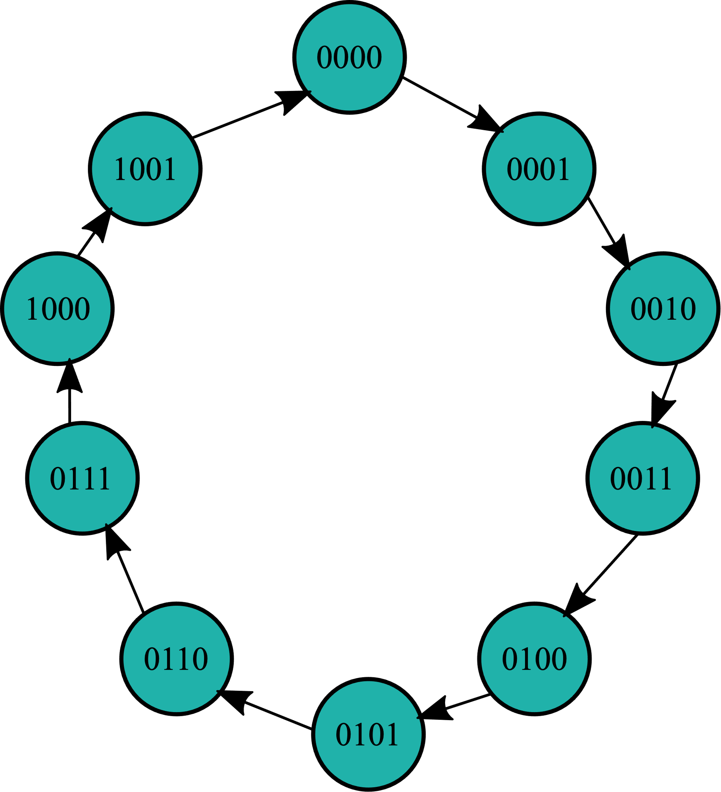
BCD synchronous Counter
A BCD counter counts in binary‐coded decimal from 0000 to 1001 and back to 0000
Because of the return to 0 after a count of 9, a BCD counter does not have a regular pattern, unlike a straight binary count

Slide 22
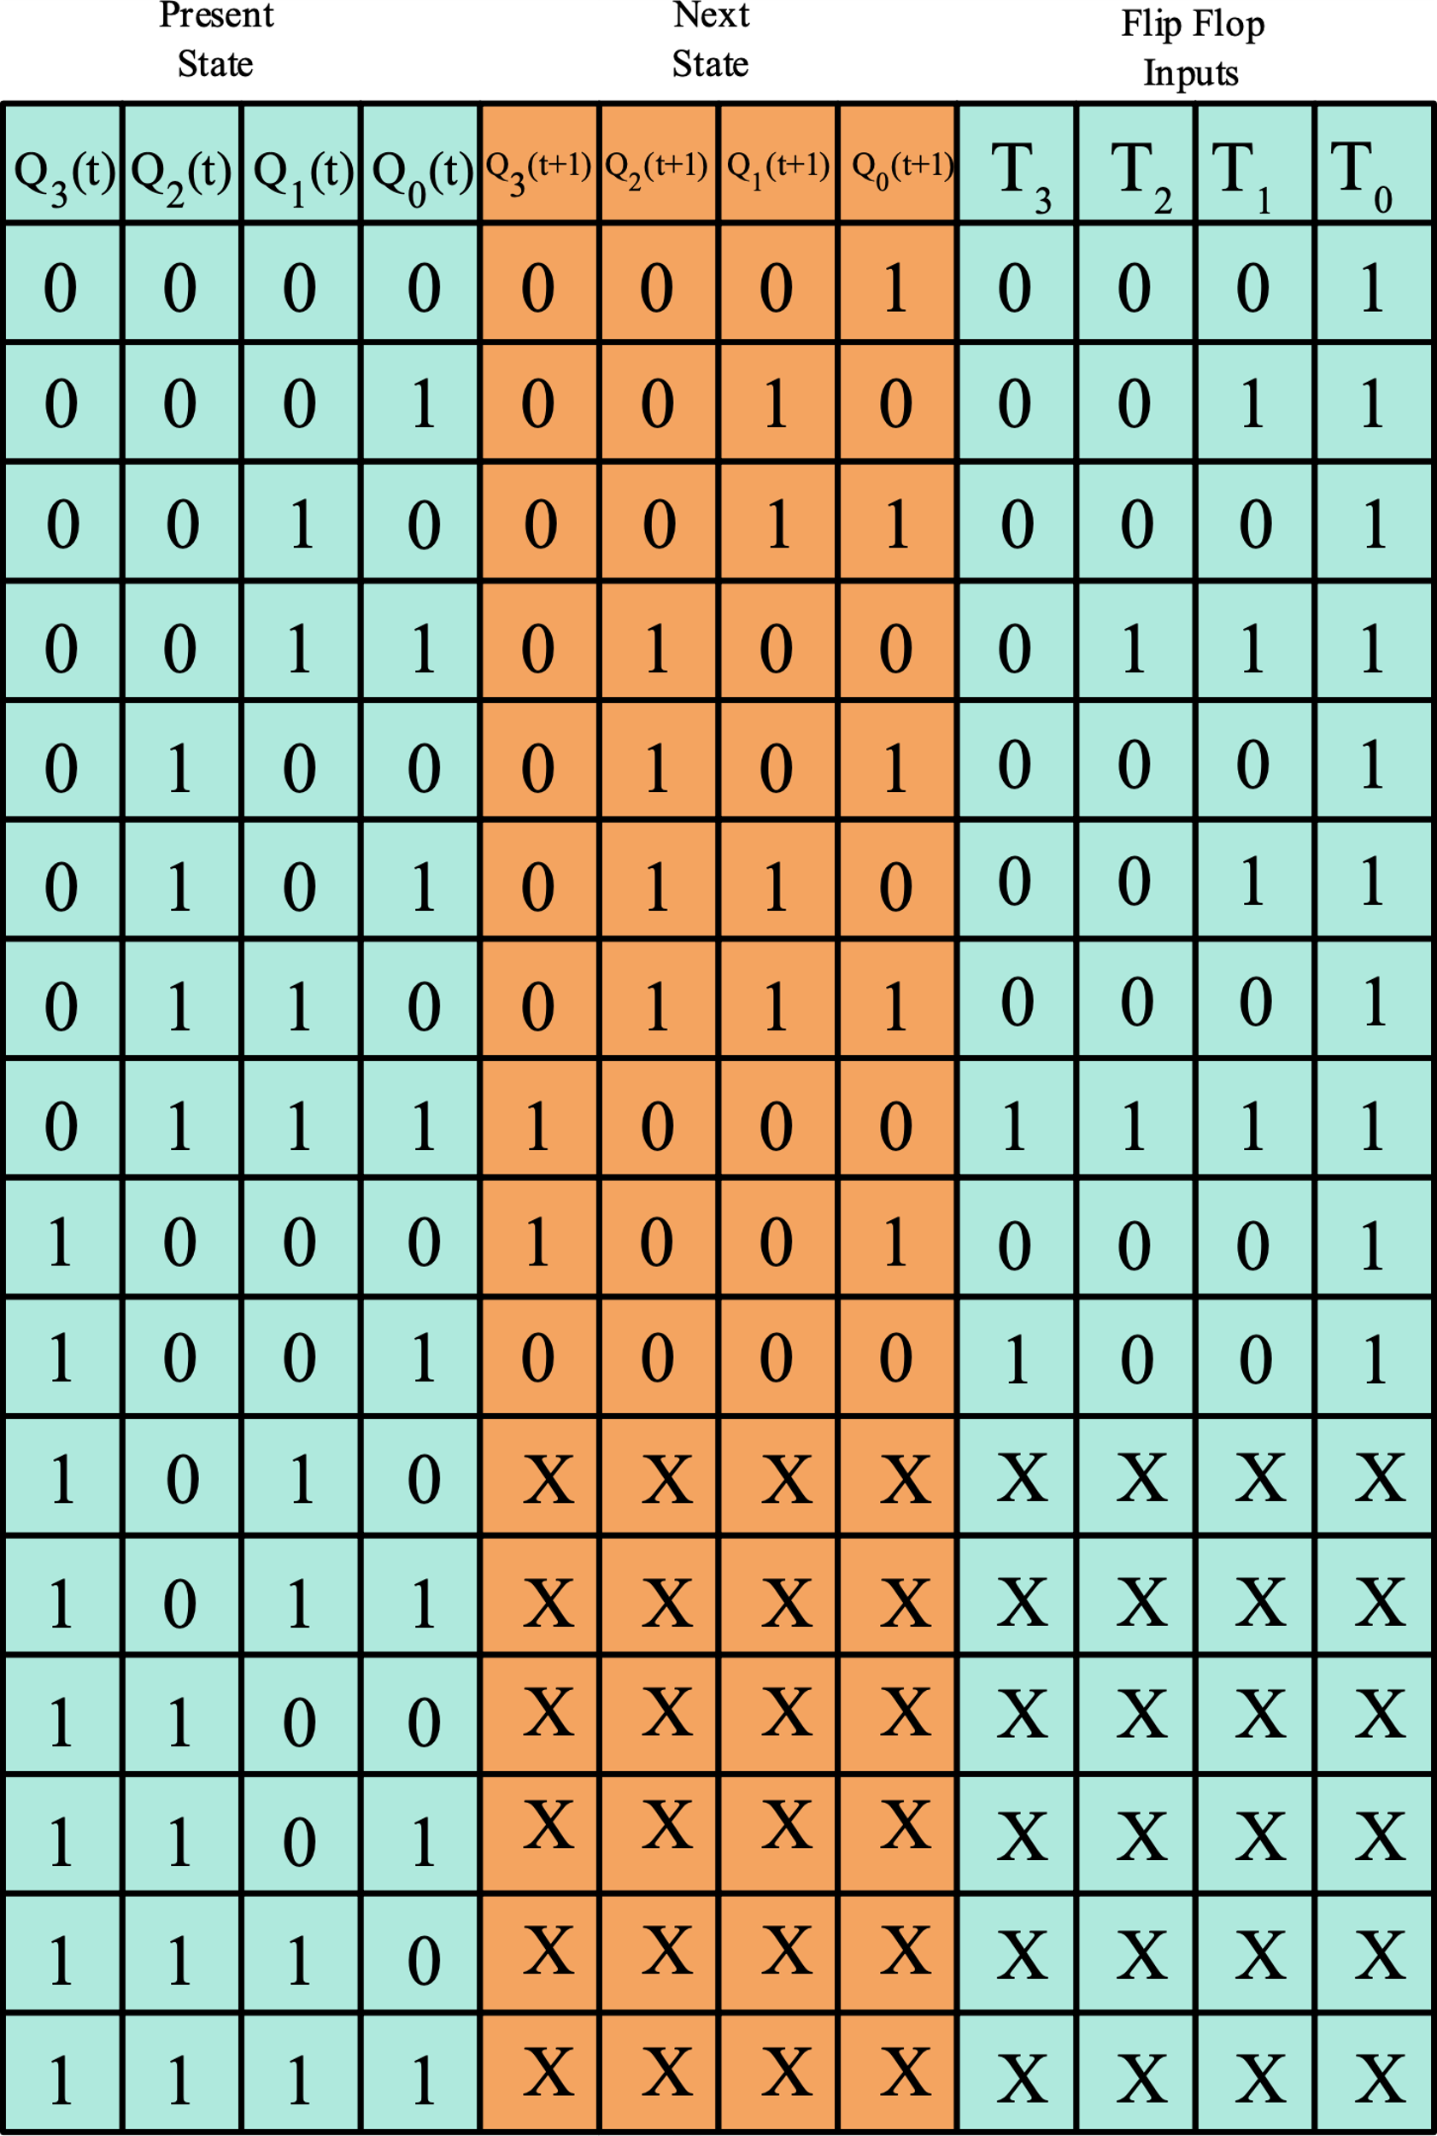
BCD synchronous Counter

Slide 23
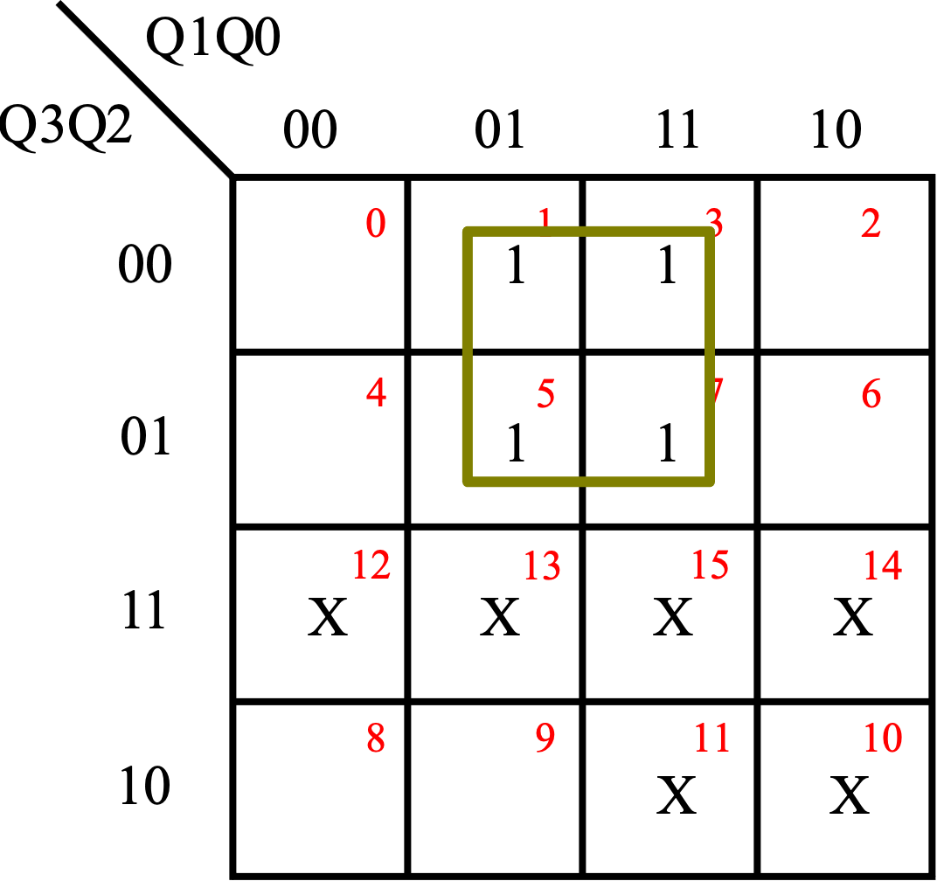
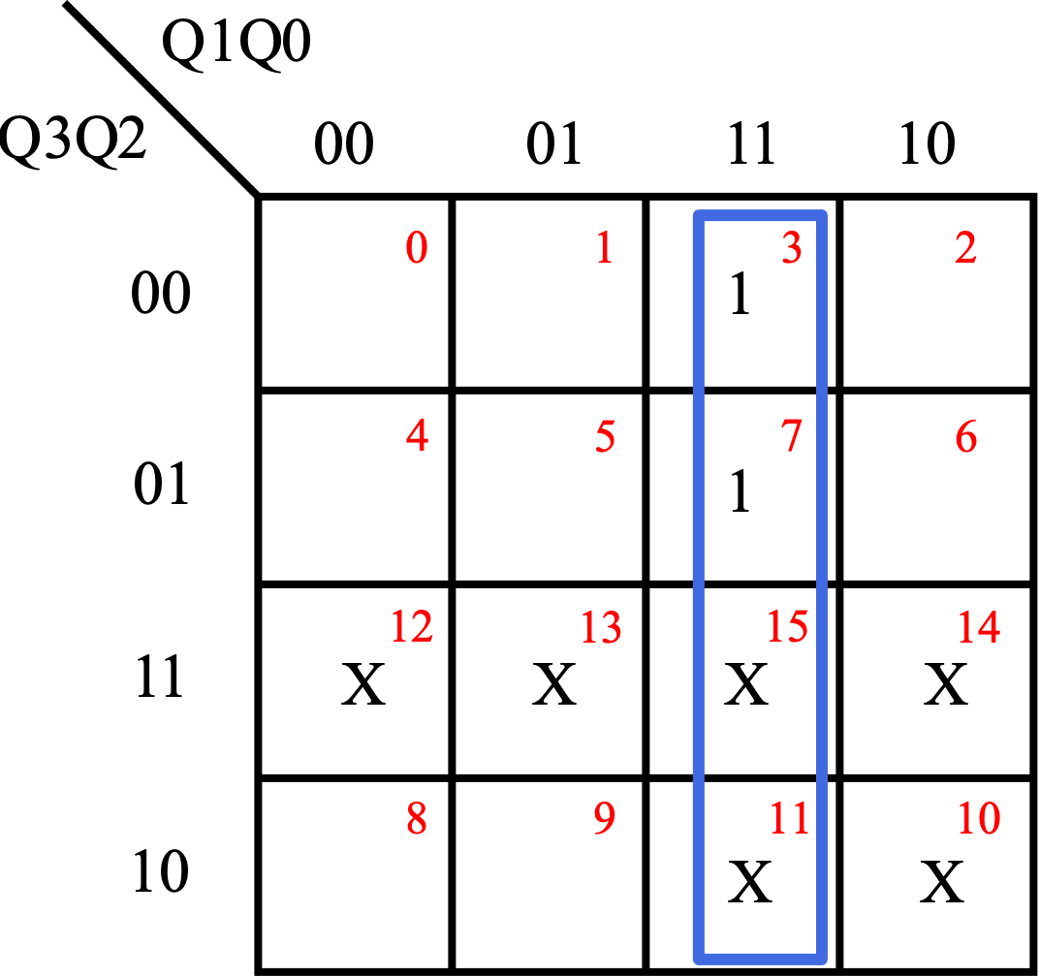
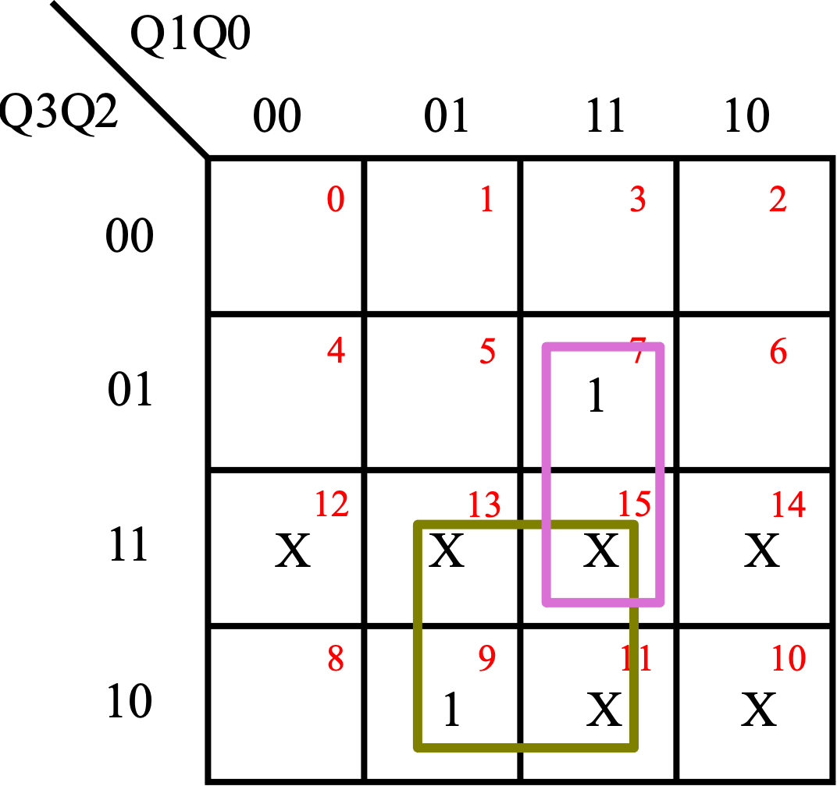
BCD synchronous Counter
T0 = 1
T1 = Q₃’Q₀
T2 = Q₁Q₀
Now that the flip flop inputs have been calculated, obtain the logic diagram
T₃ = Q₃Q₀ + Q₂Q₁Q₀

Slide 24
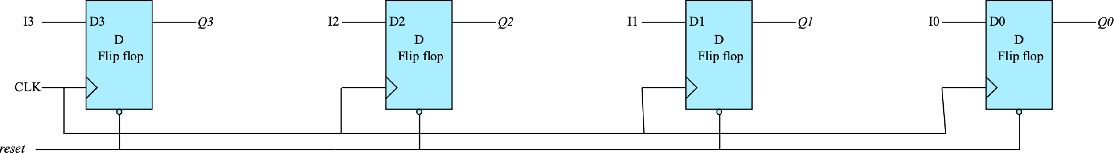
Registers
A register is a group of flip‐flops, each one of which shares a common clock and is capable of storing one bit of information.
An n‐bit register consists of a group of n flip‐flops capable of storing n bits of binary information
The simplest register is one that consists of only flip‐flops, without any gates. The figure below shows a simple 4-bit register

Slide 25
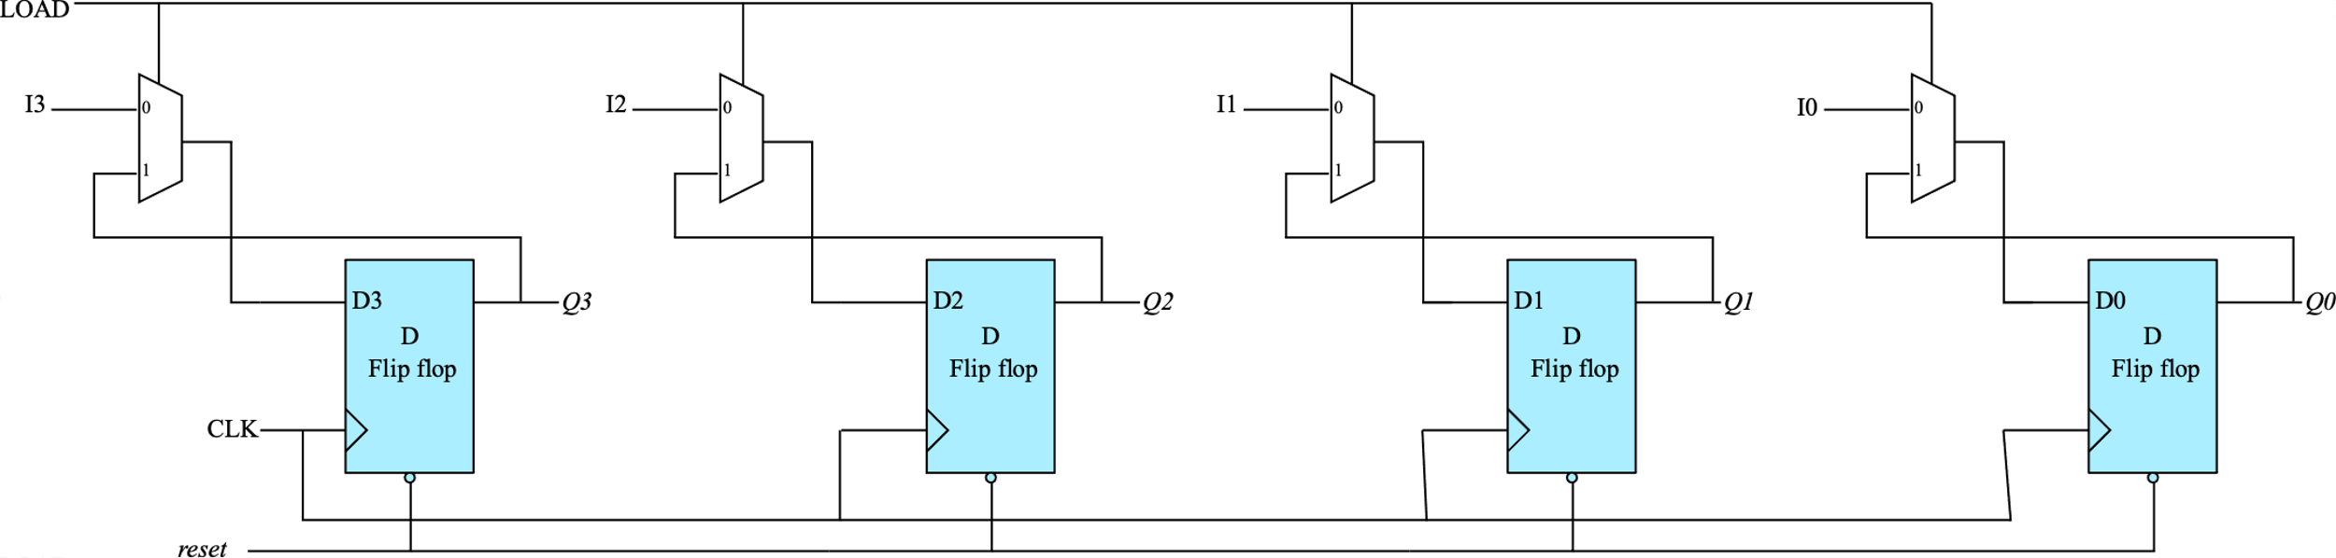
Register with parallel load
A register with parallel load has an extra input LOAD.
When LOAD =0, data is loaded into each flip flop parallelly at the same time
When LOAD =1, the register maintains its contents

Slide 26
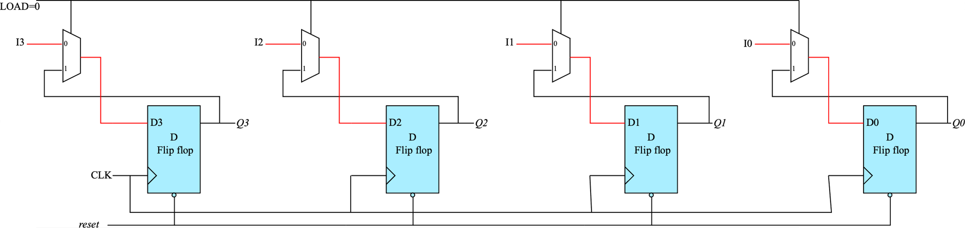
Register with parallel load
When LOAD =0 then I3, I2, I1 and I0 are loaded to D3, D2, D1 and D0 respectively

Slide 27
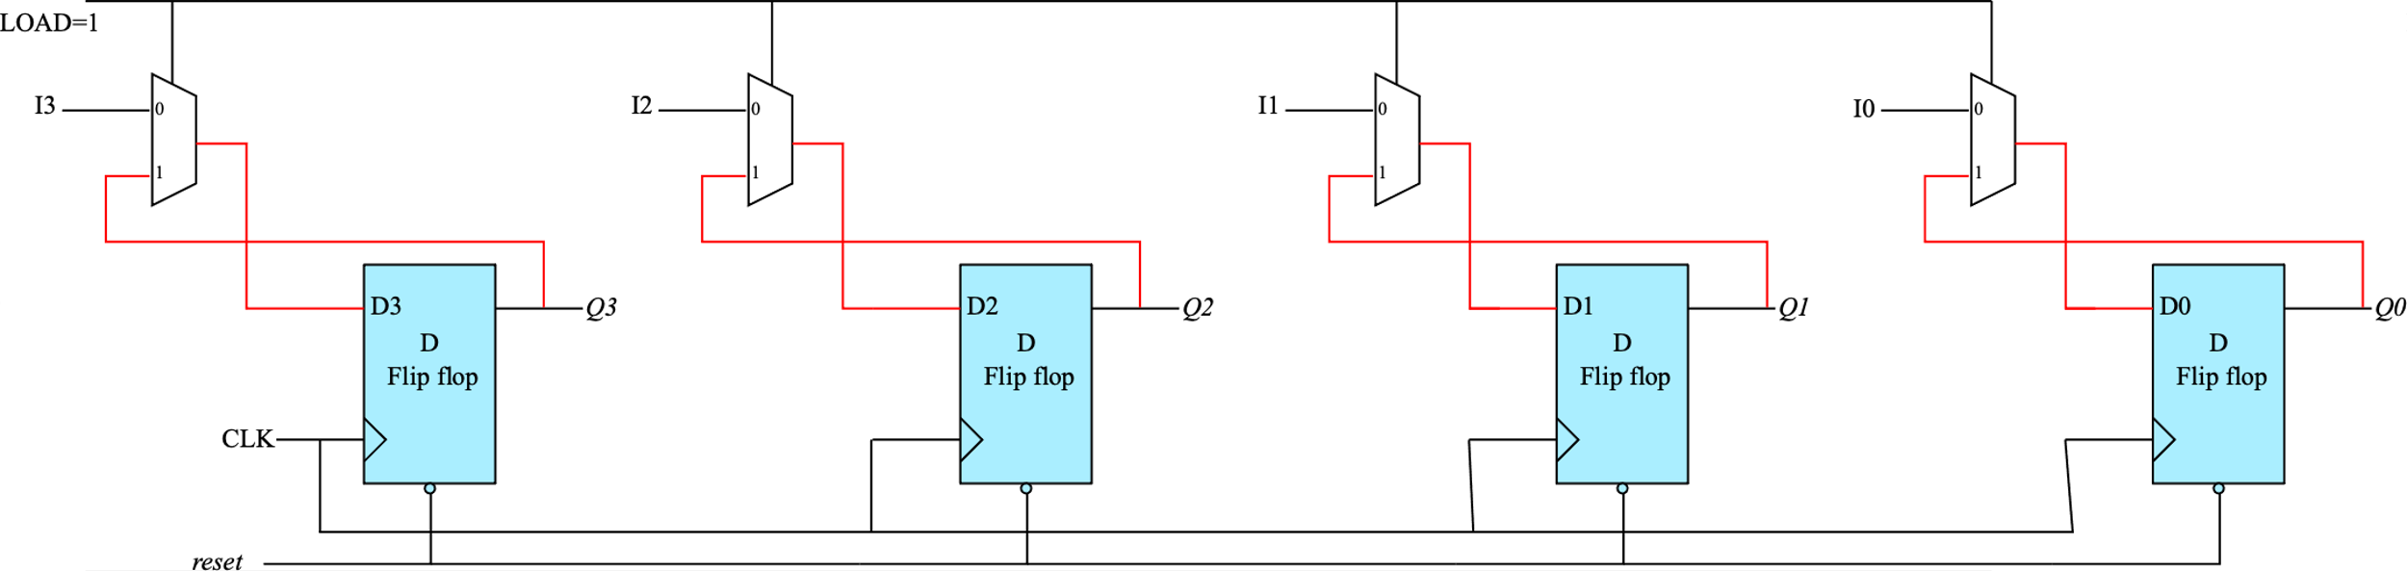
Register with parallel load
When LOAD =1 then D3, D2, D1 and D0 get the values of Q3, Q2, Q1 and Q0 respectively, thereby maintaining their values

Slide 28
Shift Registers
A register capable of shifting the binary information held in each cell to its neighbouring cell, in a selected direction, is called a shift register.
Shift register consists of a chain of flip‐flops in cascade, with the output of one flip‐flop connected
to the input of the next flip‐flop.
All flip‐flops receive common clock pulses, which activate the shift of data from one stage to the next

Slide 29
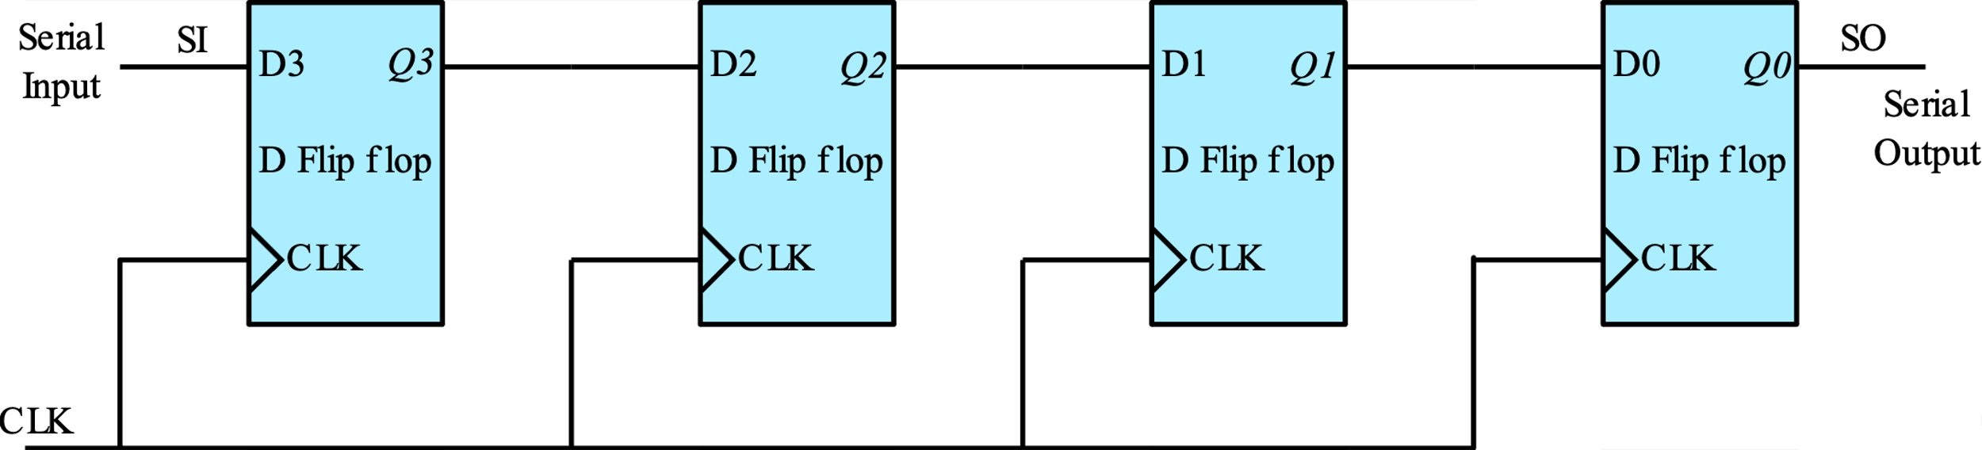
Shift Registers
Each clock pulse shifts the contents of the register one bit position to the right.
The serial input determines what goes into the leftmost flip‐flop during the shift
The serial output is taken from the output of the rightmost flip‐flop
***** Refer to the animation for a better understanding *****

Slide 30
Types of Shift Registers
SISO – Serial Input Serial Output. Data is input serially into the register and the output is obtained serially (1-bit input, 1-bit output)
SIPO - Serial Input Parallel Output. Data is input serially and the output is probed at all the flip flop outputs. (1-bit input, n-bit output)
PISO – Parallel Input Serial Output. Data is initially loaded parallelly and then shifted serially out (n-bit input, 1-bit output)
PIPO - Parallel Input Parallel Output. Data is initially loaded parallelly and then shifted serially. But the outputs of all the flip flops are probed to read the n-bit output (n-bit input, n-bit output)

Slide 31
Bidirectional Shift Register
The figure shown above is a unidirectional shift register. It moves data serially from left to right. It is also called right shift register
It is often required in digital systems to perform left shift as well along with right shift. A shift register that can shift data from left to right and right to left is called a bidirectional shift register

Slide 32
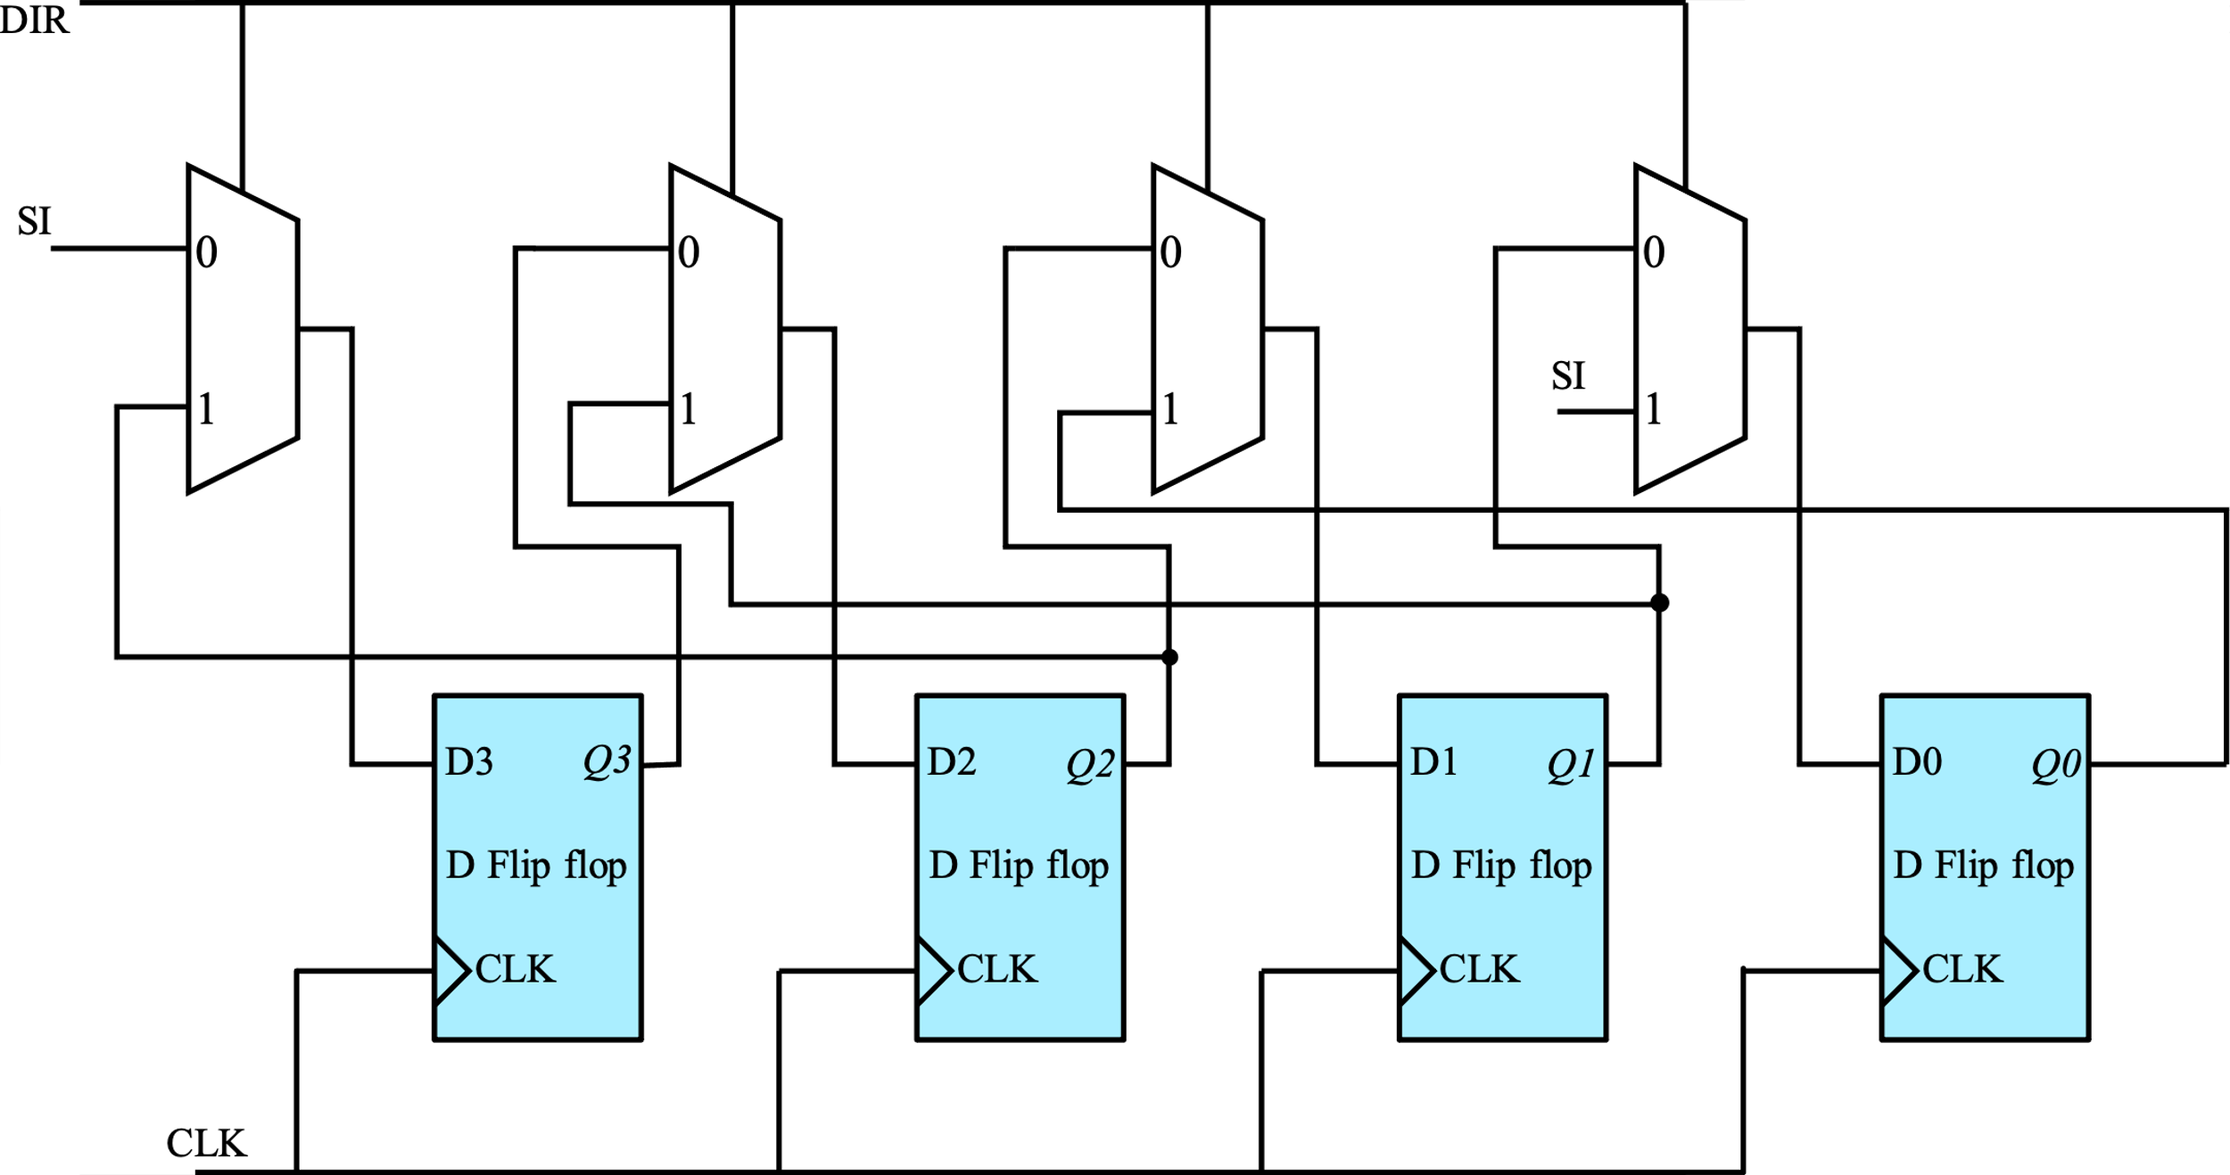
Bidirectional Shift Register
The figure below shows the logic diagram of a bidirectional shift register. When DIR =0, it performs right shift and when DIR =1, it performs left shift

Slide 33
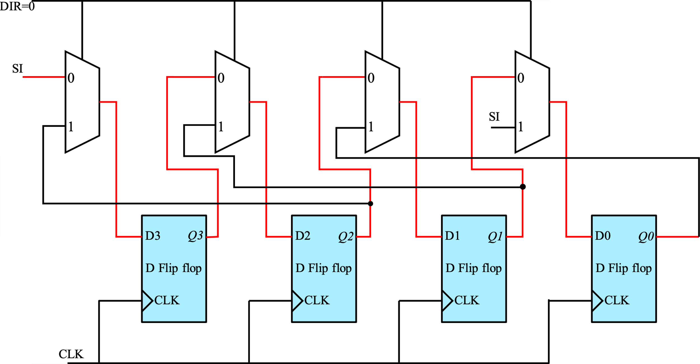
Bidirectional Shift Register
When DIR =0, the data moves towards right at the occurrence of clock edge

Slide 34
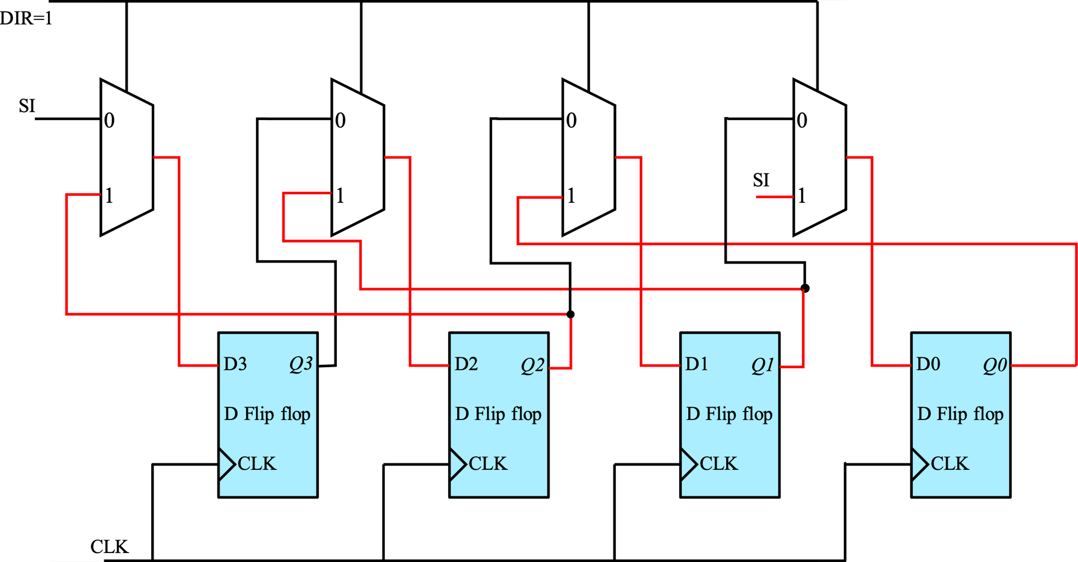
Bidirectional Shift Register
When DIR =1, the data moves towards left at the occurrence of clock edge

Slide 35
Universal Shift Registers
The most general shift register has the following capabilities
A clear control to clear the register to 0
A clock input to synchronize the operations
A shift‐right control to enable the shift‐right operation and the serial input and output lines associated with the shift right
A shift‐left control to enable the shift‐left operation and the serial input and output lines associated with the shift left
A parallel‐load control to enable a parallel transfer and the n input lines associated with the parallel transfer
n parallel output lines
A control state that leaves the information in the register unchanged in response to the clock

Slide 36
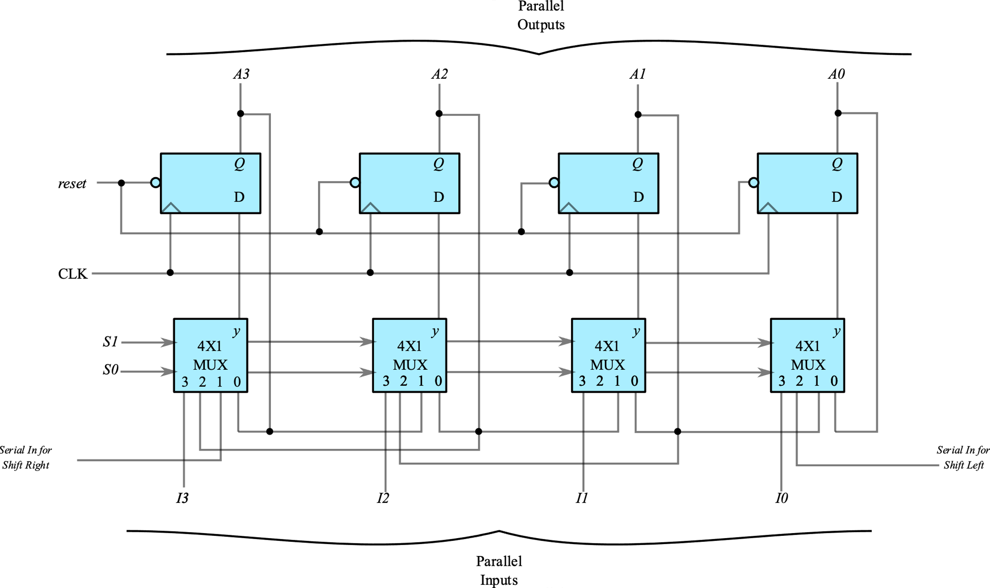
Universal Shift Registers

Slide 37
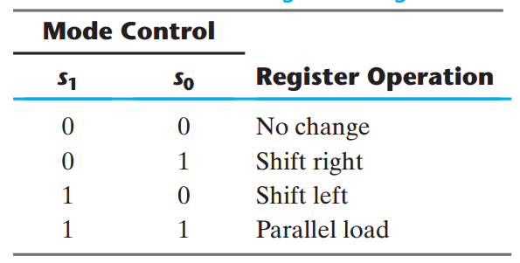
Universal Shift Registers
4 X 1 Muxes is used in a universal shift register.
This mux has two Select lines S1 and S0
The mode of operation for these S1 and S0 values is listed in the table below

Slide 38
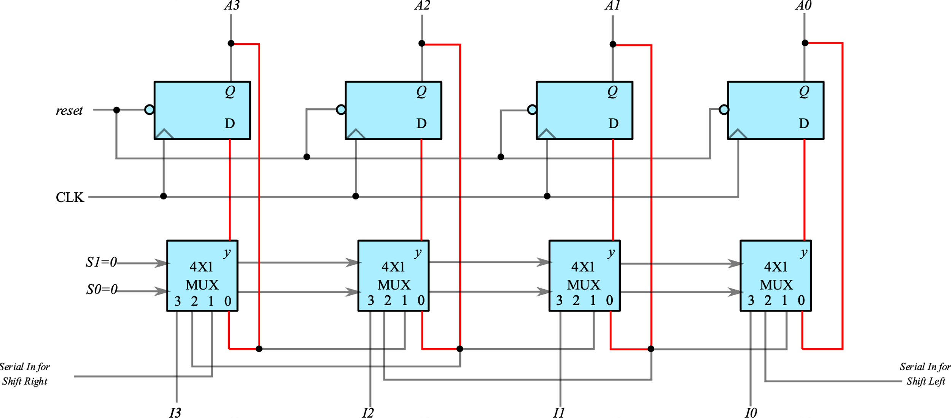
Universal Shift Registers
S1=0,S0=0 No change

Slide 39
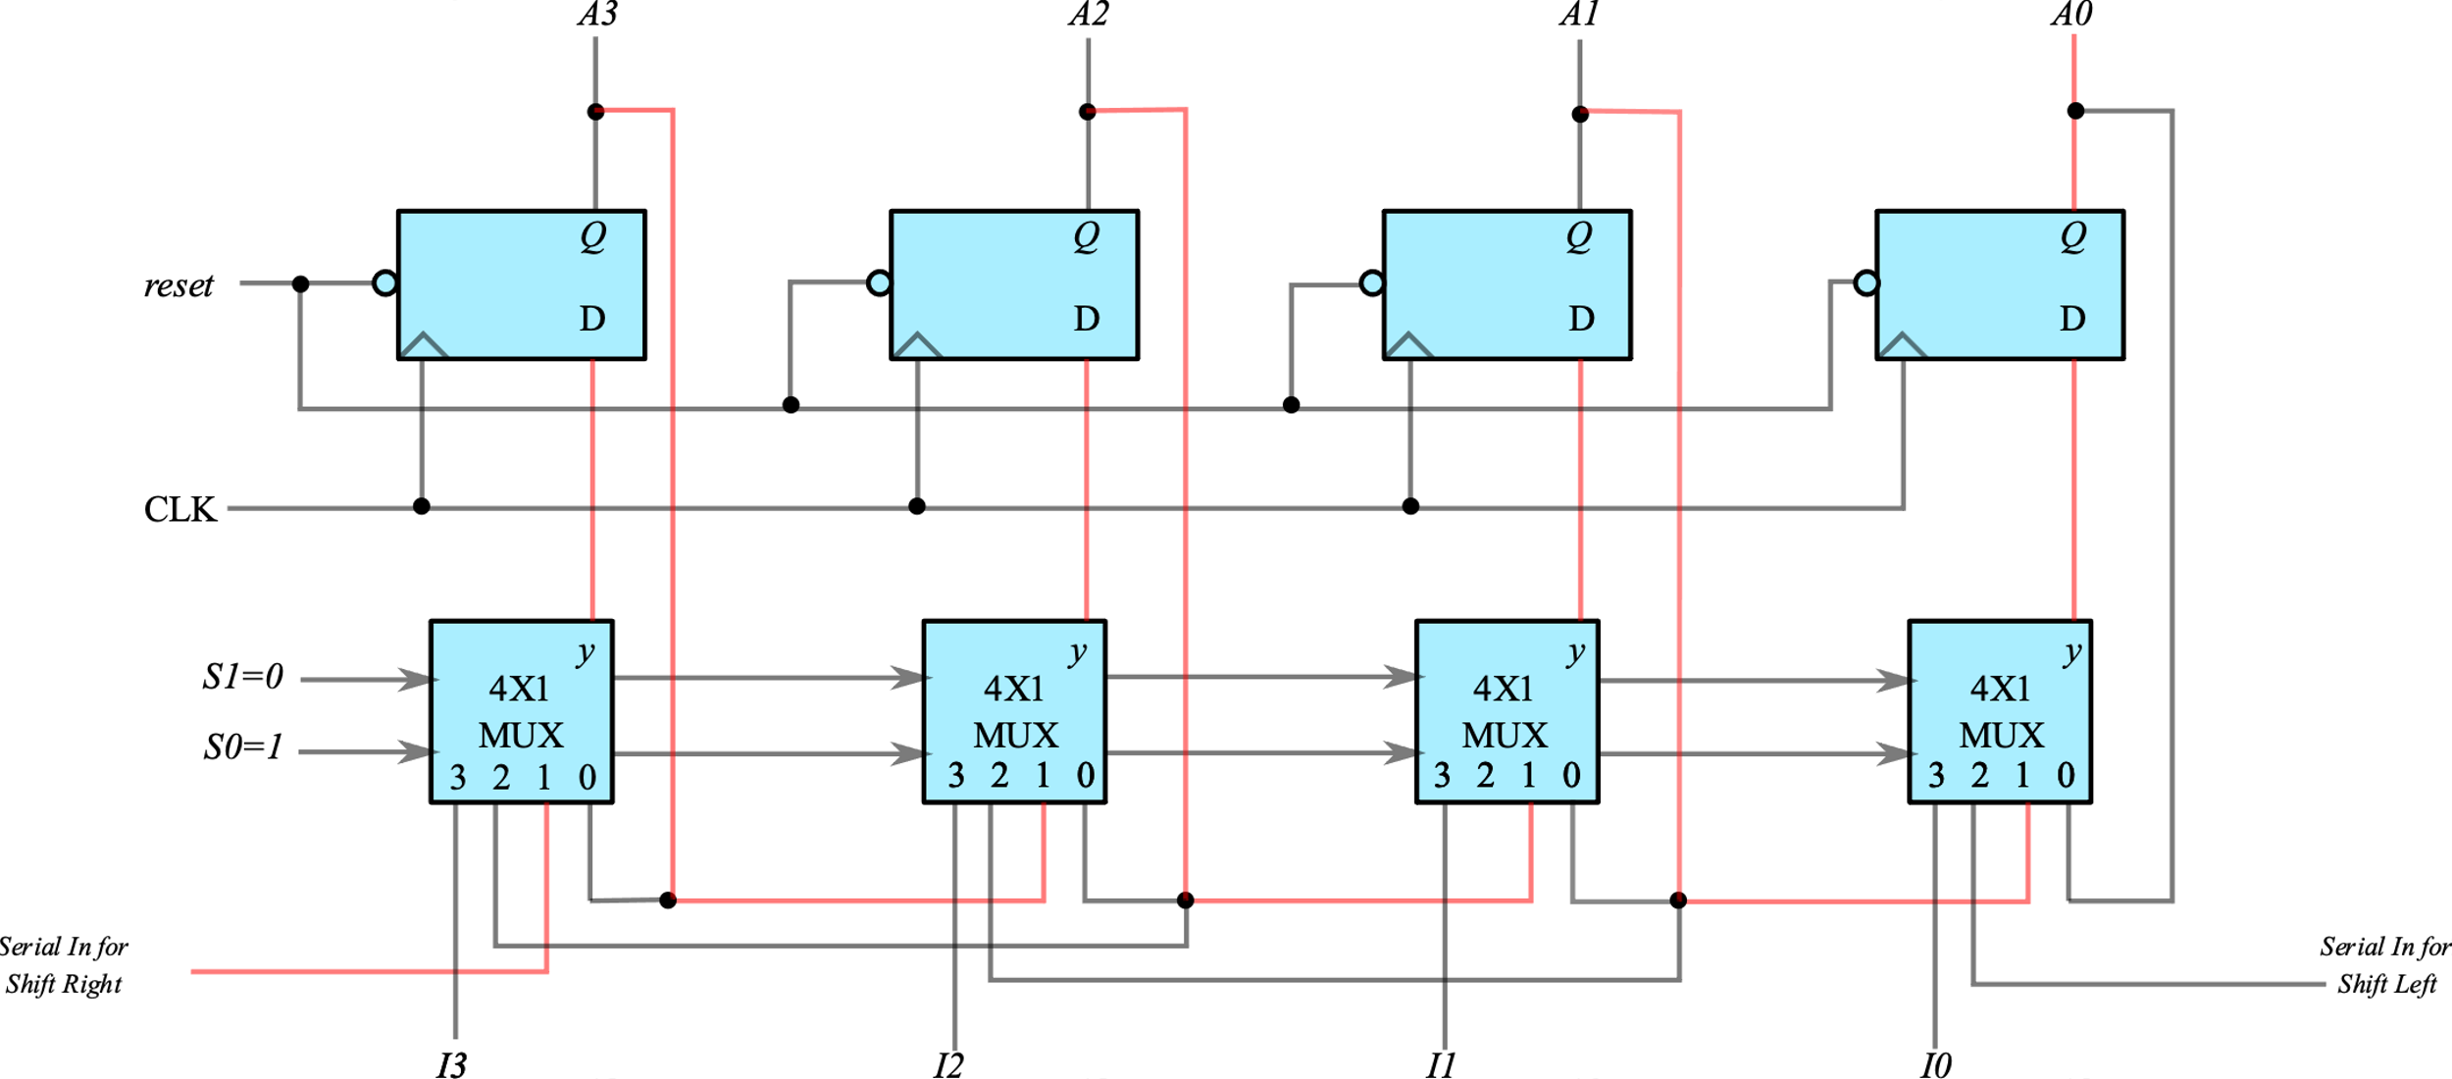
Universal Shift Registers
S1=0,S0=1 Right Shift Register

Slide 40
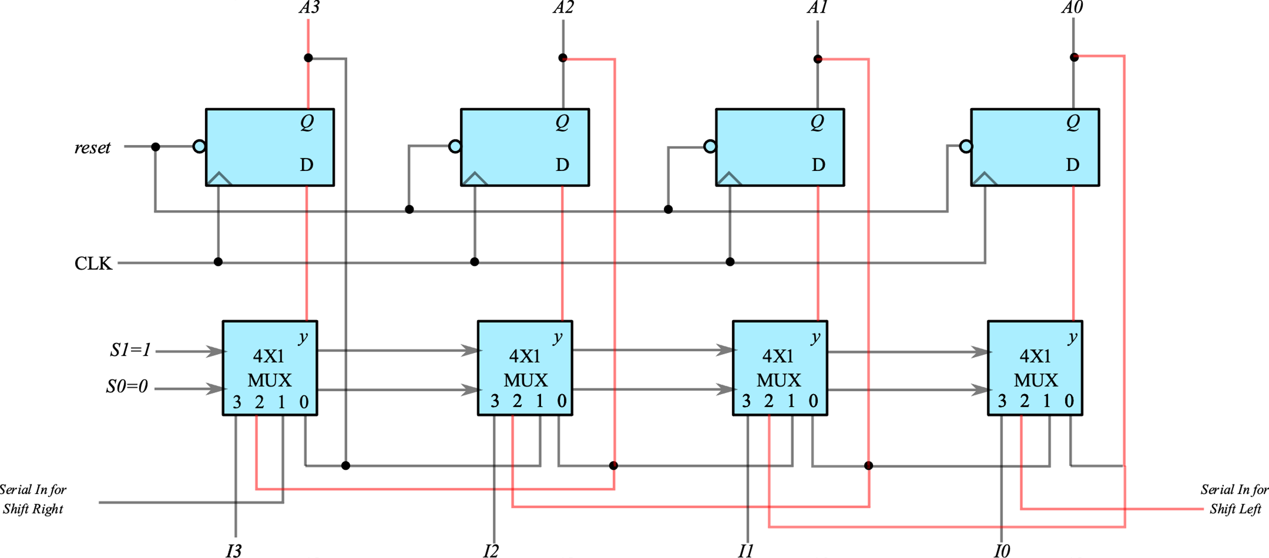
Universal Shift Registers
S1=1,S0=0 Left Shift Register

Slide 41
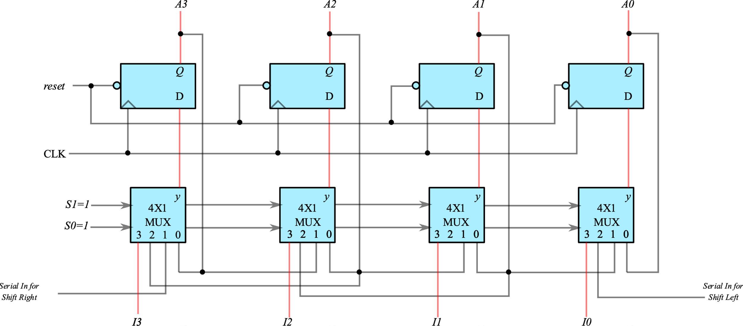
Universal Shift Registers
S1=1,S0=1 Parallel Load

